Slide 1

Islam, family & women elementary course in Islam 2011
We must remember what life had been like for women in the pre-Islamic period when female infanticide was the norm and when women had no rights at all. Like slaves, women were treated as an inferior species, who had no legal existence. In such a primitive world, what Muhammad achieved for women was extraordinary. The very idea that a woman could be witness or could inherit anything at all in her own right was astonishing.
Karen Armstrong emphasizes that, during the Middle Ages; ... the Muslims were horrified to see the way Western Christians treated their women in the Crusader states, and Christian scholars denounced Islam for giving too much power to menials like slaves and women
Karen Armstrong, Muhammad A Biography of The Prophet, Harper Collins Publisher, USA, 1992, p.199
Karen Armstrong, Muhammad A Biography of The Prophet, Harper Collins Publisher, USA, 1992,p.191

Slide 2

the Universal Declaration of Human Rights was drafted between January 1947 and December 1948
All human beings are born equal in dignity and rights.
Everyone is entitled to all the rights and freedoms set forth in this Declaration, without distinction of any kind such as race, colour, sex, language, religion, political or other opinion, national or social origin, property, birth or other status
Rights set forth include the right to life, liberty, a fair trial, free speech, privacy, of personal security, and of movement, as well as freedom from slavery, torture, and arbitrary arrest.
These rights are specified as an indispensable aspect of an individual's life, being necessary for one's dignity and personal development, and include economic rights.
Composed of 53 member states, the Commission on Human Rights is the Charter-based body that most directly deals with the area of human rights.

Slide 3
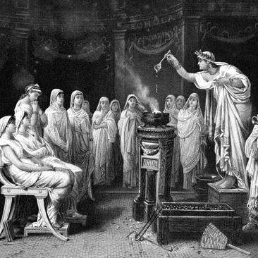
“In Athens, “woman’s status had degenerated to that of slaves. Wives were secluded in their homes, had no education & few rights, and were considered by their husbands no better than chattels….”
“In ancient Rome, a woman’s legal position was one of complete subordination, first to the power of her father or brother and later to that of her husband, who held paternal power over his wife. In the eyes of the law, women were regarded as imbeciles.”
Encyclopedia Britannica (1984) vol. 9 p. 909

Slide 4
Women in Pre-Islamic era
Prior to the advent of Prophet Muhammad what was the status of women in his tribal societies of Arabia.
One day, after Muhammad’s declaration of his Prophet hood, one of his Companions came to him and narrated what he had done with his little daughter:
O Messenger of God, I had a daughter. One day I told her mother to dress her as I was taking her to her uncle - the poor mother knew what this meant, but she could do nothing but obey and weep. My wife dressed the infant, who was rejoicing at the news of going to the uncle. I took her near a well, and told her to look down into the well.
While she was looking into the well, I kicked her into it. While she was rolling down, she was shouting ‘Dad, Dad!’
As he was recounting this, the Prophet, sobbed as if he had lost one of his nearest kinsfolk.
Darimi, Sunan, Muqaddima, 7-8

Slide 5

Women in pre-islamic era
Women cannot choose or refuse in Marriage
Women had no inheritance of any kind
Women did not engage in commerce or trade
Women also were forbidden to remarry if a husband divorced them.
If a woman’s deceased husband had adult sons from other marriages, the oldest son amongst them had the right to add the wife of his deceased father to his household; exactly as such a son inherits the wealth of his deceased father. This widow, the wife of the deceased, was unable to leave the house of her stepson unless she paid a ransom for her life and liberation.
Women were forbidden to eat certain food.

Slide 6

Rights granted to women by Islam
O mankind! reverence your Guardian-Lord, who created you from a single person, created, of like nature, His mate, and from them twain scattered (like seeds) countless men and women;- reverence God, through whom ye demand your mutual (rights), and (reverence) the wombs (That bore you): for God ever watches over you.
Glorious Qur’an Ch. 4 V. 1
Prophet Muhammad said:
Verily, women are the twin halves of men.
Recorded in Abu Dawood, Tirmidhi & others

Slide 7

Islamic virtuous deeds are not limited to honoring and respecting women, but rather, we can add that Islam is the first religion to honor and respect them. We can easily prove this by illustrating that all religions and nations, prior to the advent of Islam, caused much harm and insult to women.
Gustave Le Bond, the well-known French thinker stated in his book The civiliation of Arabs 1884
Religious Obligations
Rewards and Punishments
Preservation of Honor and Nobility
Financial Dealings and Property Ownership
Education and Caring
Right to Receive Fair Share of Wealth

Slide 8

Polygamy in hinduism
In Hinduism
Polygamy was practiced in many sections of Hindu society in ancient times. In Ramayana, father of Ram, King Dasharath has three wives, but Ram has pledged himself just one wife. The Hindu god, Lord Krishna, the 9th incarnation of the Hindu god Vishnu had 16,108 wives at his kingdom in Dwarka. In the post-Vedic periods, polygamy declined in Hinduism, and is now considered immoral.
Although the Vedas and the Hindu religion itself do not outlaw polygamy, the terms under the Hindu Marriage Act has deemed polygamy to be illegal for Hindus, Jains, Buddhists, and Sikhs.

Slide 9

Polygamy in Buddhism
In Buddhism
In Buddhism, marriage is not a sacrament. It is purely a secular affair and the monks do not participate in it, though in some sects priests and monks do marry (e.g. Japan). Hence it receives no religious sanction. Forms of marriage consequently vary from country to country.
Polyandry in Tibet as well was common traditionally, as was polygyny, and having several wives or husbands was never regarded as having sex with inappropriate partners. Tibet is home to the largest and most flourishing polyandrous community in the world today. Other forms of marriage are also present, like group marriage and monogamous marriage.

Slide 10

Polygamy in judaism
In Judaism
Polygamy existed among the Israelites before the time of Moses, who continued the institution without imposing any limit on the number of marriages which a Hebrew husband might contract.
While there is no evidence of a polyandrous state in primitive Jewish society, polygamy seems to have been a well-established institution, dating from the most ancient times and extending to comparatively modern days.
In modern Israel, where a wife cannot bear children or is mentally ill, the rabbis give a husband the right to marry a second woman without divorcing his first wife.
Polygamy was prohibited in Judaism by the rabbis, not God.

Slide 11

Polygamy in christianity
In Christianity
According to Father Eugene Hillman, ‘Nowhere in the New Testament is there any explicit commandment that marriage should be monogamous or any explicit commandment forbidding polygamy.’
The Church in Rome banned polygamy in order to conform to Greco-Roman culture that prescribed only one legal wife while tolerating concubinage and prostitution.
The Roman emperor, Valentinian I, in the fourth century, authorized Christians to take two wives. In the eighth century Charlemagne, holding power over both church and state, in his own person practiced polygamy, having six, or according to some authorities, nine wives. According to Joseph Ginat, the author of Polygamous Families in Contemporary Society, the Catholic Church frowned on the practice, but occasionally sanctioned second marriages for political leaders.
In the United States, polygamy is illegal, but it exists unofficially, with an estimated 30,000 to 80,000 people living as polygamists in the West. Typically, these families are Mormon fundamentalists or Christian groups that maintain polygamy is a time-honored and scriptural practice.

Slide 12
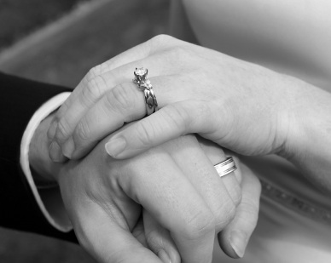
Polygamy in Hong Kong
In Hong Kong, polygamy was banned in October 1971.
Some Hong Kong businessmen have concubines across the border in mainland China, but concubines do not have the legal or social status of wives and so this should not strictly be called "polygamy".

Slide 13
Rights & duties of husband & wife
And among His Signs is this, that He created for you mates from among yourselves, that ye may dwell in tranquility with them, and He has put love and mercy between your (hearts): verily in that are Signs for those who reflect.
Glorious Qur’an Ch. 30 V. 21
Prophet Muhammad said:
“Those who are the best believers are those who have the best manners & the most kind to their families.”
Recorded in Tirmithi & others
“The best of you is the best to his family & I am the best of you to my family.”
Recorded in Tirmithi

Slide 14
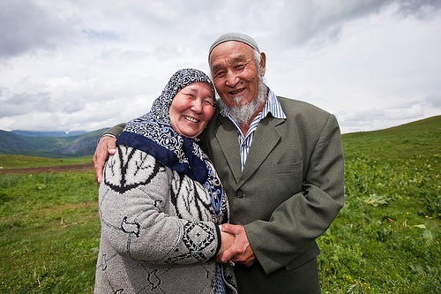
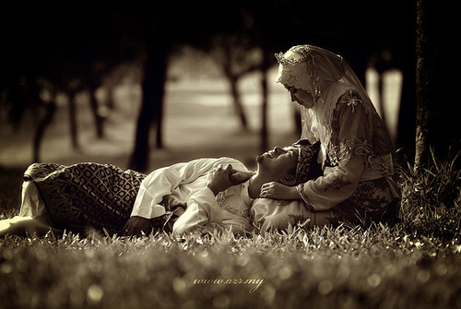
Rights & duties of husband & wife
General Rights
To be treated with honor, kindness, and patience.
To enjoy intimate relations with each other.
To have children, by God's will.
To keep one's legal and personal identity after marriage, retaining one's own family name, inheritance rights, property, mahr, etc.
General Duties
To be faithful to the marriage bond.
To strive to be attractive to one's spouse.
To assist and support one another, and to resolve disputes amicably.
The husband has the duty to provide all physical maintenance of the family (housing, clothing, food, medical care, etc.).

Slide 15
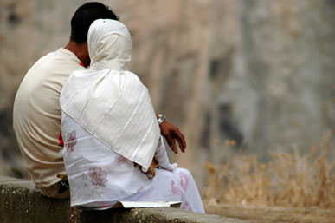
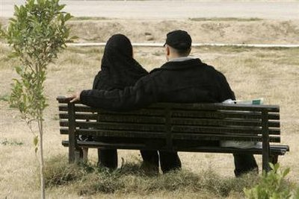
Family harmony & it’s problem
Couples are bound to face difficulties and get frustrated with one another from time to time.
O you who have believed, it is not lawful for you to inherit women by compulsion. And do not make difficulties for them in order to take [back] part of what you gave them unless they commit a clear immorality. And live with them in kindness. For if you dislike them - perhaps you dislike a thing and Allah makes therein much good.
Glorious Qur’an Ch.4 V. 19

Slide 16
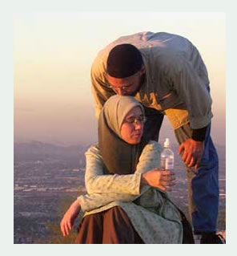
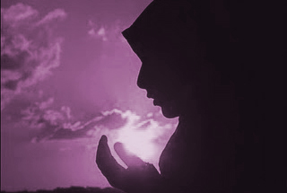
Family harmony & it’s problem
Prophetic tradition
‘Only a man of noble character will honor women, and only a man of base intentions will dishonor them’
Recorded in Kanz al-Ummal
Shall I not tell you what the best object of your charity is? It is your own daughter who has returned to you as a widow, or a divorcee, and who has no one to earn for her except you.
Recorded Sunan Ibn Majah, Kitab al-Adab

