Slide 1
CONTRIBUTIONS OF ISLAM TO CIVILIZATION
Sadaqat Khan
MUSLIMS CONTRIBUTION TO THE WORLD CIVILIZATION
SADAQAT KHAN
KOWLOON MASJID AND IISLAMIC CENTRE

Slide 2
Civilization Definition
An Advanced state of Intellectual, Culture, and material development in Human Society, marked by progress in the arts, and sciences.
Technologically advanced.
American Heritage dict

Slide 3
What Factors motivated the
Muslims Civilization?

Slide 4
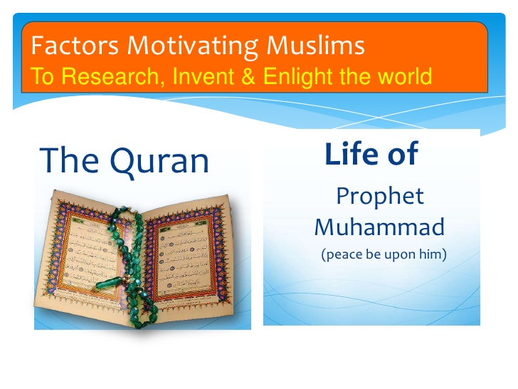

Slide 5
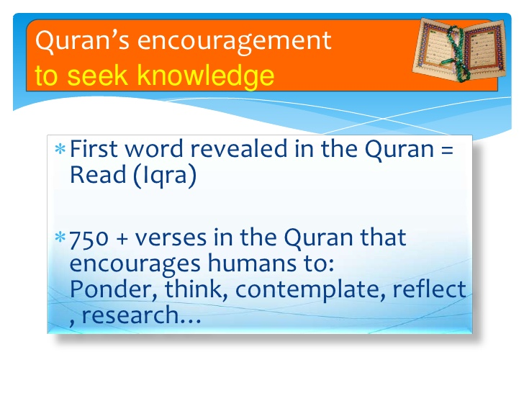

Slide 6


Slide 7
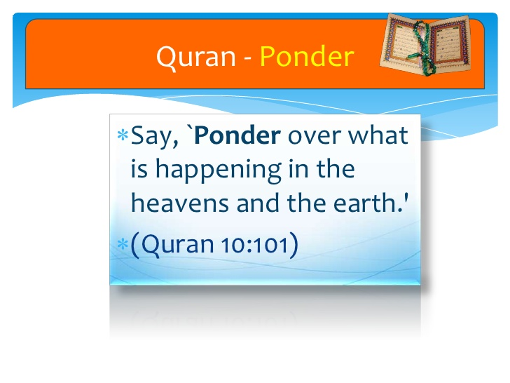

Slide 8
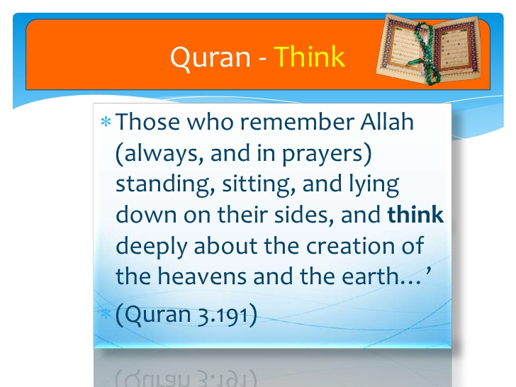

Slide 9
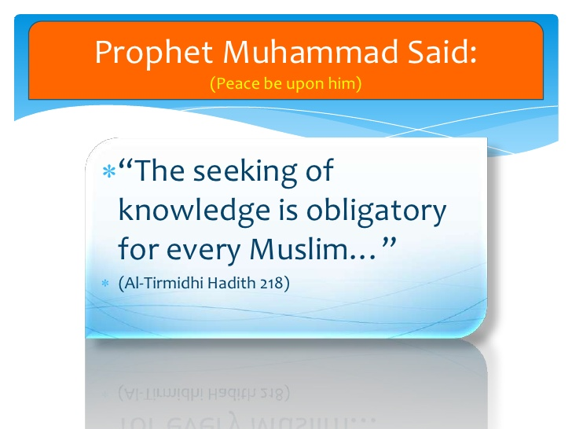

Slide 10
OPINIONS OF THE WESTERN SCHOLARS ABOUT MUSLIMS CONTRIBUTIONS TO CIVILIZATION
Marquis of Dufferin and Ava, Speeches Delivered in India, p.24
  The Europe is indebted to the Muslims
  Science, Muslims Art and Muslims
  Literature for taking them out from the
  Darkness of the Middle Ages.

Slide 11
Victor Robinson, The Story of Medicine , p.174
  Europe was darkened at sunset, Cordova was shining with public lamps;
  Europe was dirty, Cordova built thousands of baths,
  Europe was lying in Mud, Cordova’s street were paved,
  Europe nobilities could not sign there name, Cordova’s children went to school,
  Europe Monks could not read their Bible; Cordova’s teachers created the library of Alexandrian.

Slide 12
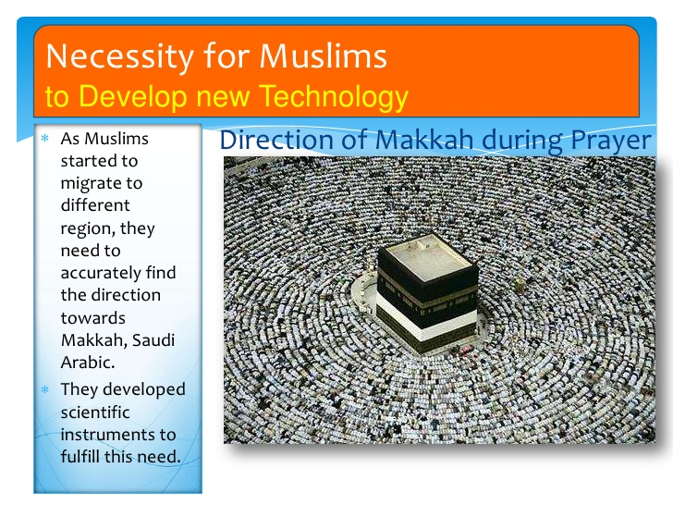

Slide 13
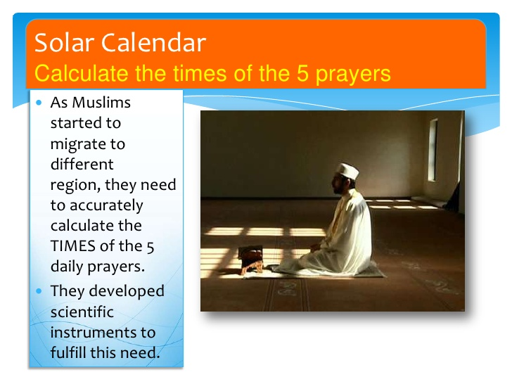

Slide 14
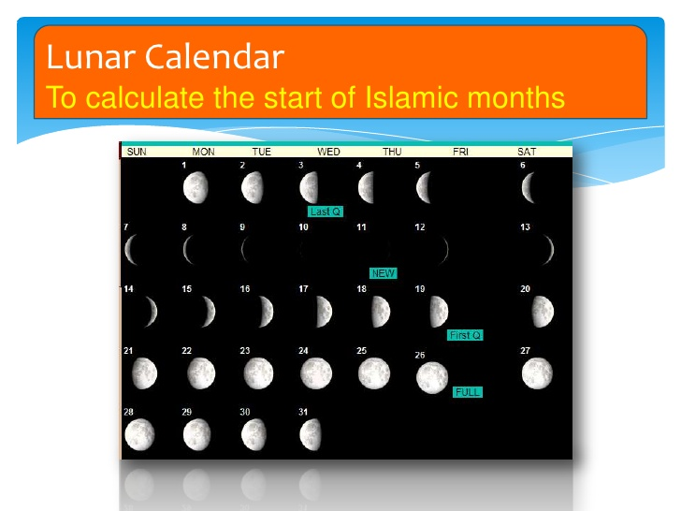

Slide 15
History
The names of the Muslims Reformer will always shine amongst the most illustrious in history. Even today, on the walls of the University Paris, pride of place is given to the two Muslims physicians.
1. Al-Razi (latinised as “Rhazes” )
2. Ibn Sina (latinised as “Avicenna”)

Slide 16
Rhazes
(865-925) was the Author of one hundred and thirteen major and twenty-eight minor works on medicine, all of which were translated into Latin to be use in the medical schools of Western Europe, Throughout the Europe, Latin in those days was used as a medical Language.
Rhazes was the first Doctor to write a book on pediatrics, or the special ailments of children. In gynecology he advocated the use of speculum for the examination of patients.
Mr Max Neuburger, an eminent writer on medical history writes about Rhazes in these words; “Rhazes was a man of rare attainments, a tireless writer of immense productiveness and an inspired teacher”.
Mr Friend says: “Rhazes discovered the cause of smallpox and many other diseases several centuries before Albert Buck.
According to Dr. Karl Sudhoff, Rhazes was the greatest physician of all time.

Slide 17
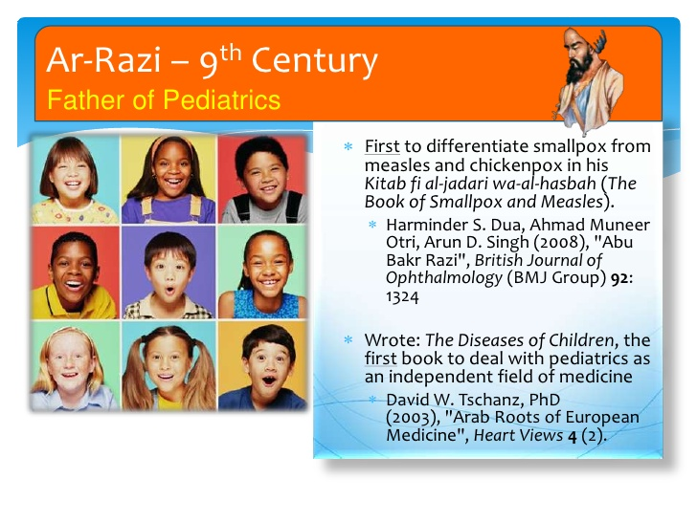

Slide 18
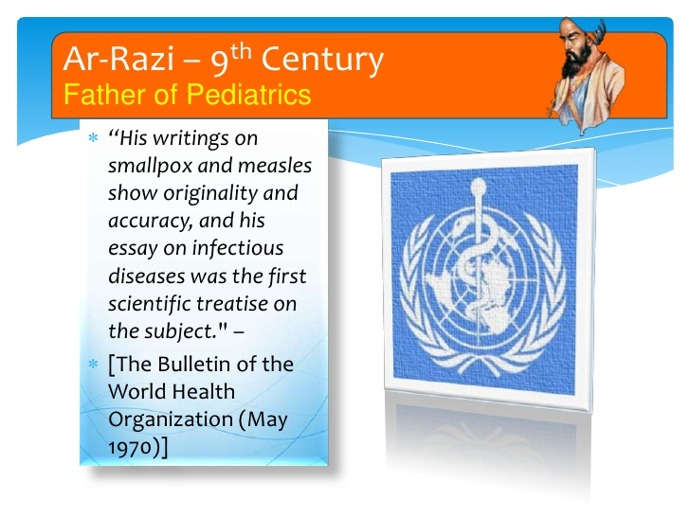

Slide 19
avicenna
He excelled in many branches of learning, however in medicine he exerted the most.
One of his outstanding work is a gigantic medical encyclopedia , which was translated into Latin by Dr. Gerard of Cremona in 12th century.
Born in Bokhara (Circa 980)
He was known as the Prince of philosophers.
There after it was used as a text book in the universities of Western Europe.

Slide 20
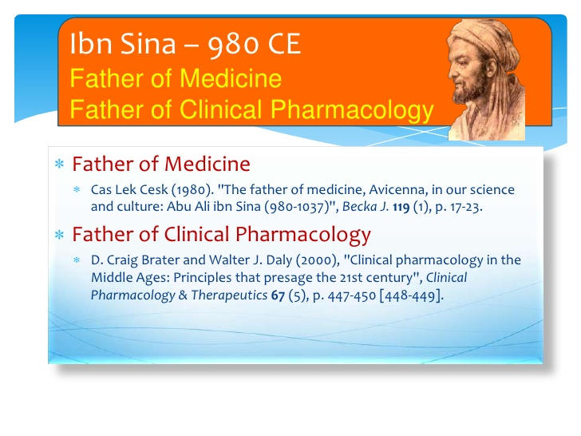

Slide 21
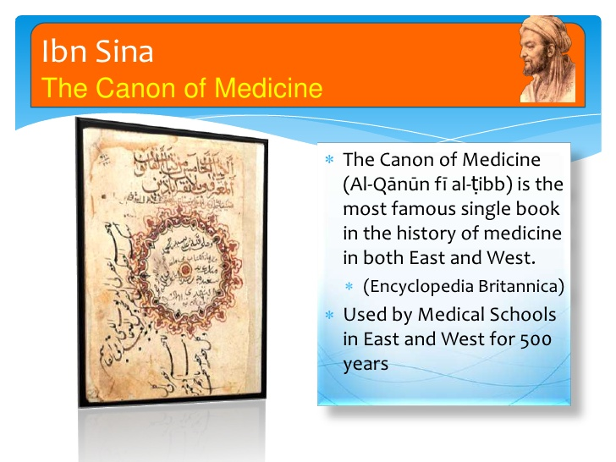

Slide 22
hospitals
The list of hospitals seems endless
In Baghdad alone the Jewish traveler,
(Benjamin of Toledo)
Noticed sixty hospitals where,
he was amazed to discover, All the patient were fed and treated at government expense.

Slide 23
One of the best Hospital in Islam
Was Built in Morocco in 1200. It was Built by Abdul Wahid Almarakeshi.
Here the poor patients were not only treated Free, But , on discharged, they were given sufficient money to maintain them until they were able to find the work again.

Slide 24
Ibn Tulun, Governor of Cairo in 872. built a hospital with an income of three Lakhs Rupees.
Here the patient received free board and Lodging as well treatment in
separate wards for separate diseases. This hospital also had a separate department for the treatment of Insane. The Historian Neuberger says, “The insane were humanely and more efficiently treated in the Mental Hospital of Islam than in Western countries.

Slide 25
In deed the first European Mental Hospital, established by the Religious order of Valencia in Spain in 1410,
Was modeled on a famous Muslim Hospital built a century before in Cairo.

Slide 26
The biggest hospital built by Muslims was the
Azad-al-Dowlah at Baghdad
And the description of it stands up well to comparison with many modern hospitals today.

Slide 27
Not only it had spacious buildings and the most up-to-date instruments but,
it had also distinguished staff has ever been found at any Medical Centre.
Indeed it was more than a hospital, it was also a University where great Scholars like Nasr Ibn Al Dukali, Abul Khair and Abu Yaqoob treated the patient and lectured the students.

Slide 28
All other Muslim Hospitals; says a European Writers,
Were overshadowed by the Hospital founded in Baghdad,
Complete with equipment, numerous trust funds and a pharmacy stocked with Medicine brought from the ends of the world.

Slide 29
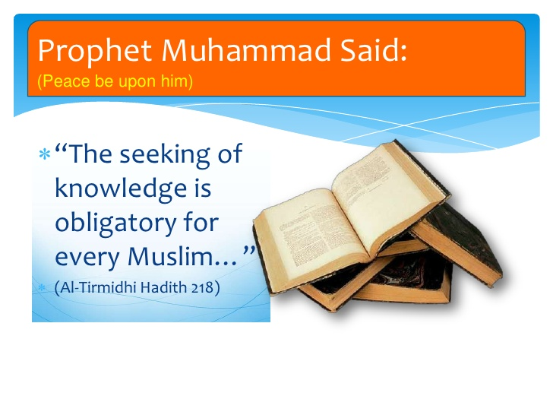
Education

Slide 30
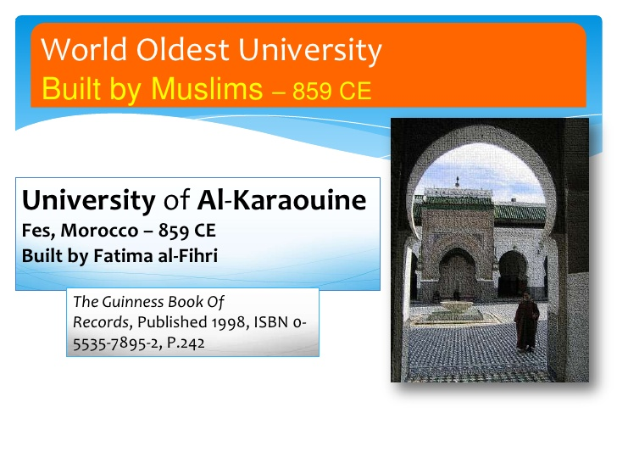

Slide 31
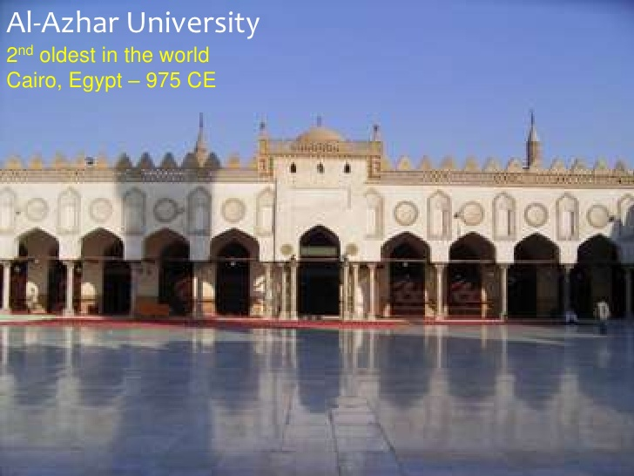

Slide 32
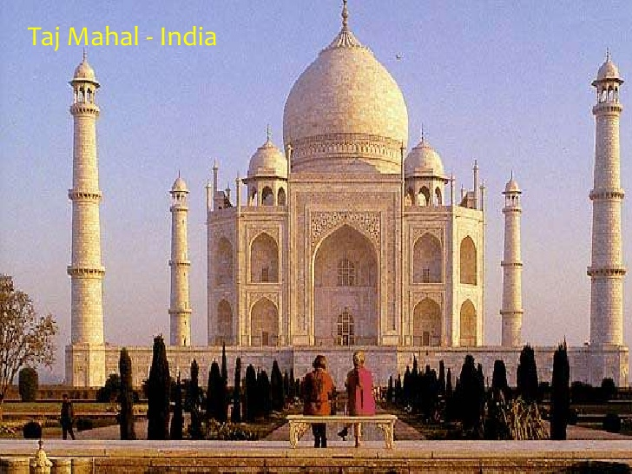
Architecture

Slide 33
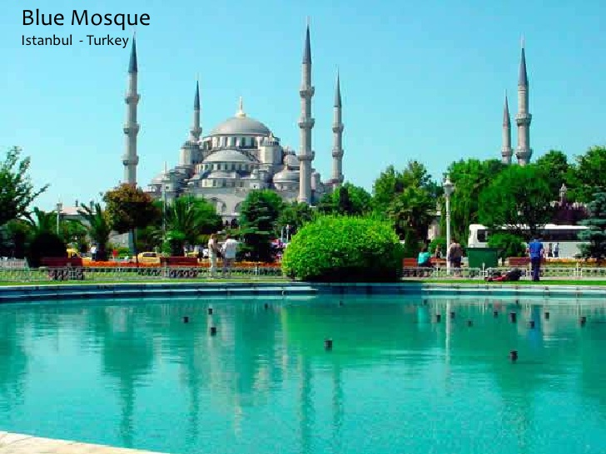

Slide 34
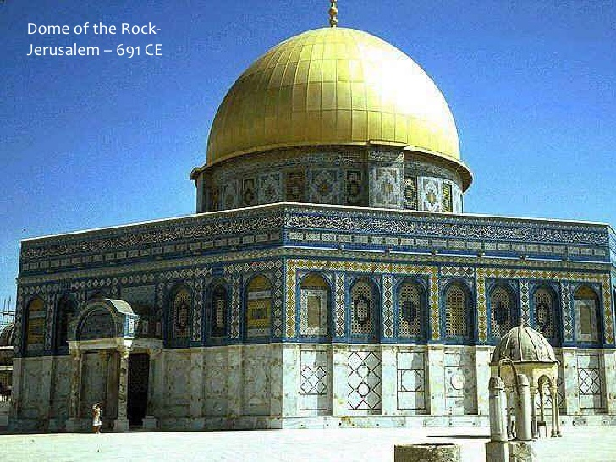

Slide 35
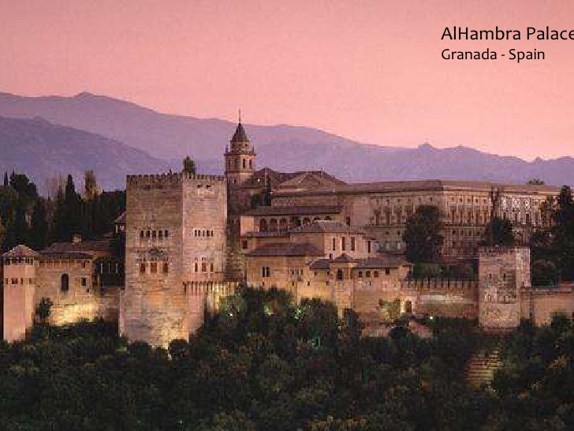

Slide 36
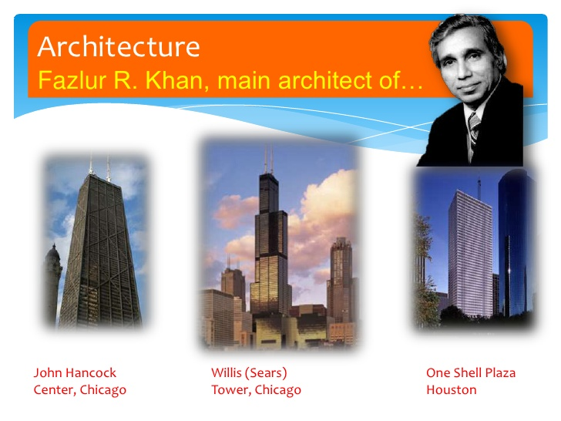

Slide 37


Slide 38


Slide 39
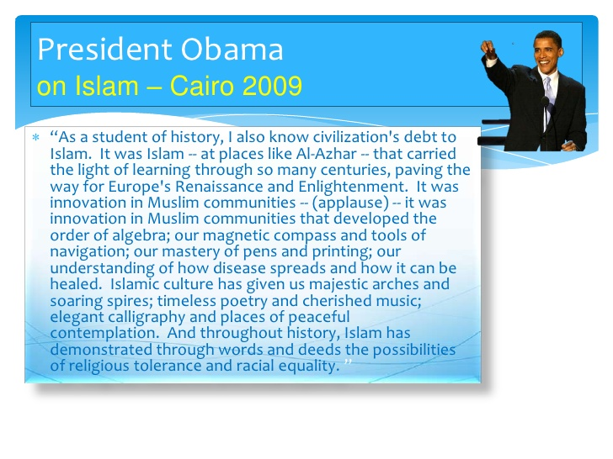

Slide 40
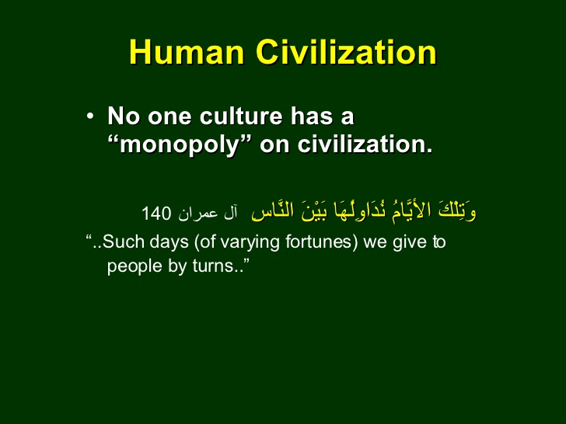

Slide 41
Thanks for your kind Attention.

