Slide 1


Slide 2
Agenda
Brainstorm the word ‘Islam’
Lecture on M65
Q & A
DAN discussion

Slide 3
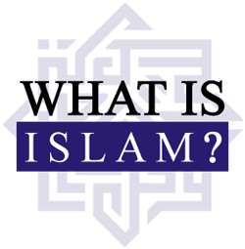
Notes:
Use the board plus marker plus invite elaboration
1) A way of life not just a religion
2) 1.3 billion Muslims - 1 out of every 5 people is a Muslim – 20% of the world’s population

Slide 4
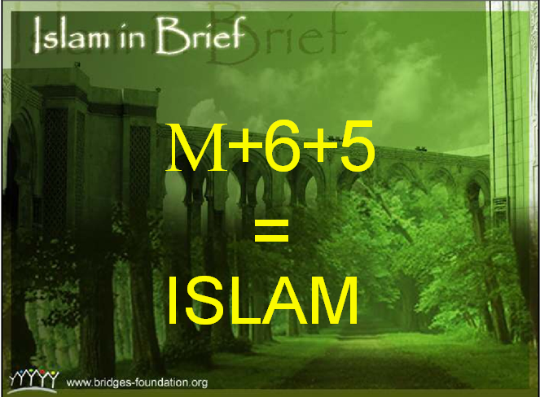

Slide 5
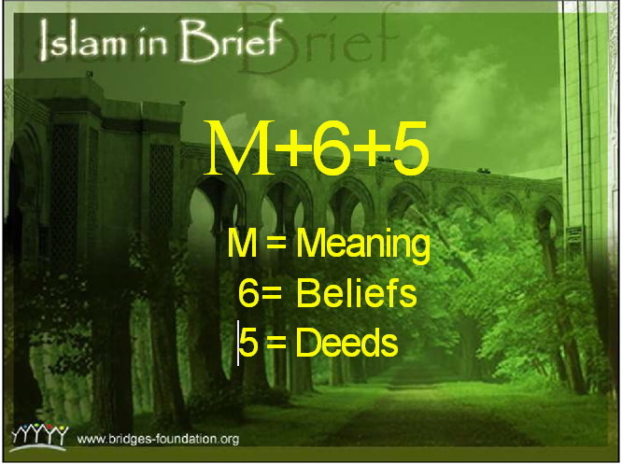

Slide 6
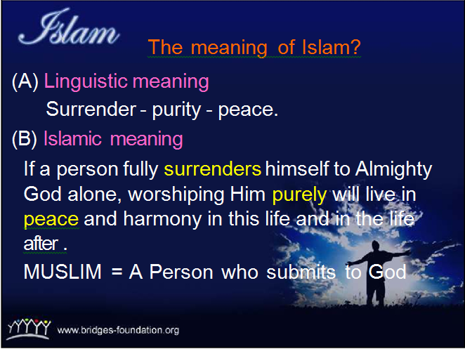

Slide 7
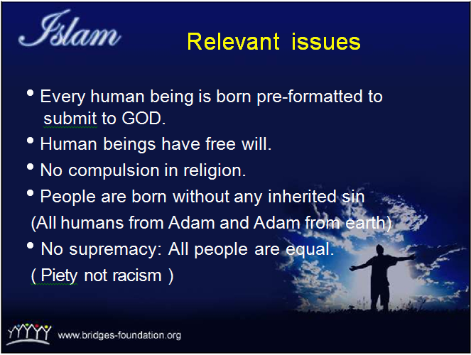

Slide 8
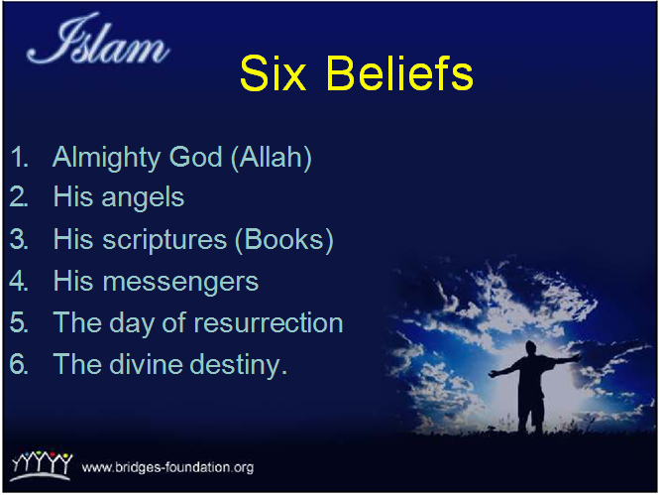

Slide 9
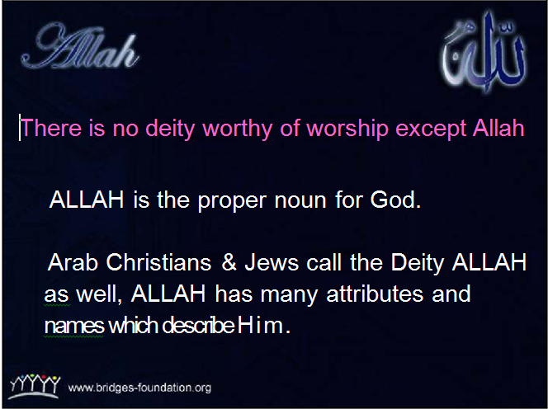

Slide 10
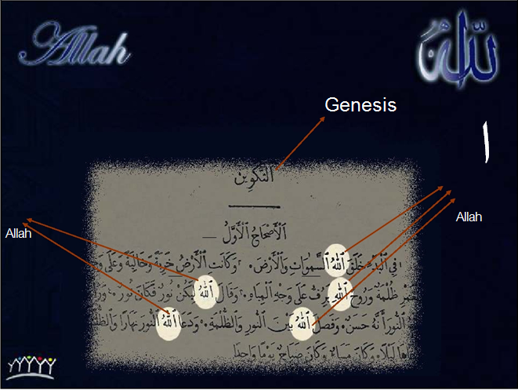

Slide 11
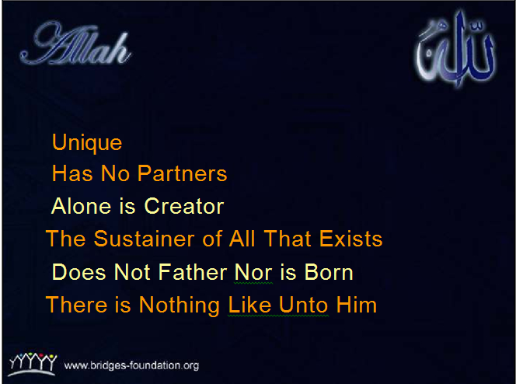

Slide 12
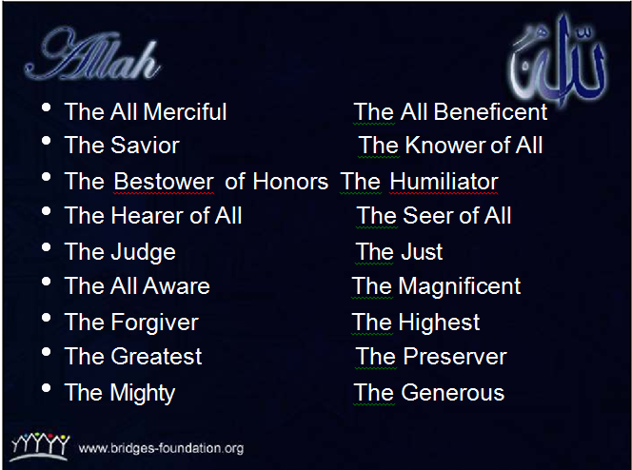

Slide 13
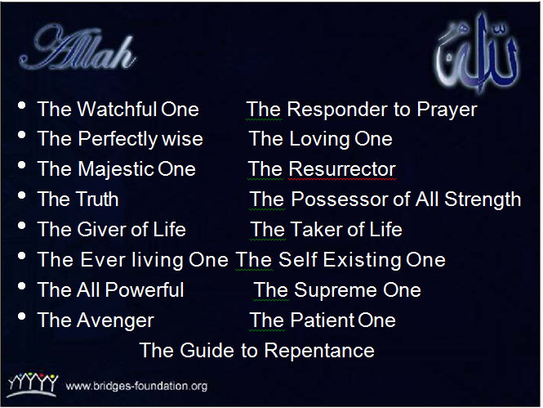

Slide 14


Slide 15
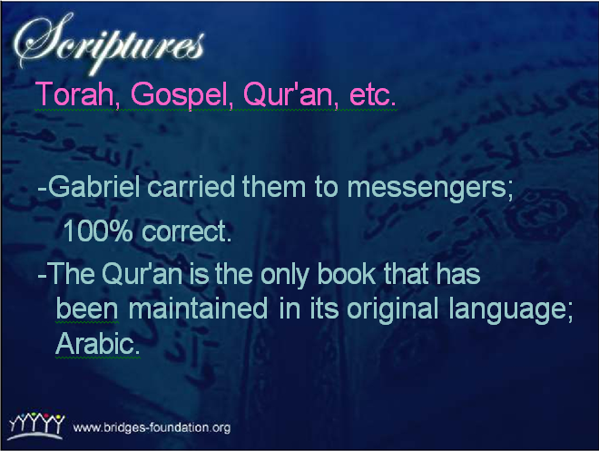

Slide 16
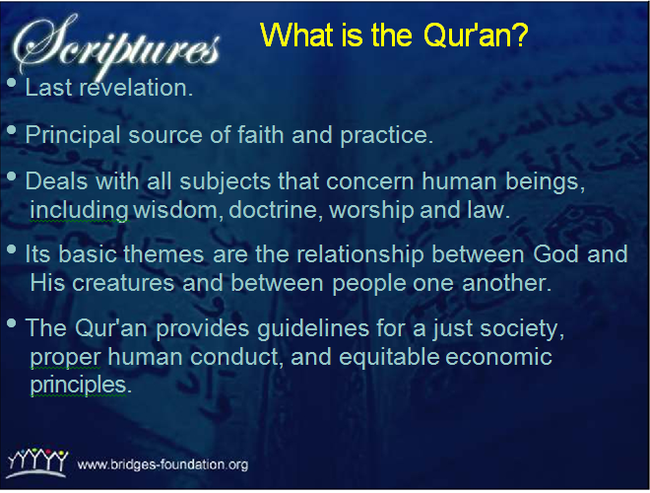

Slide 17
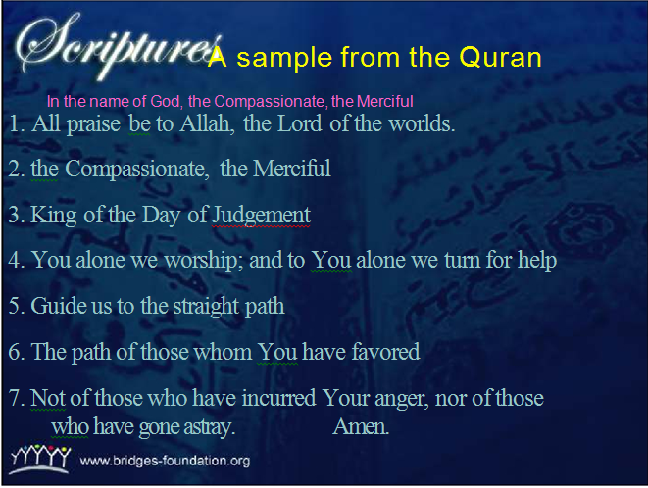

Slide 18
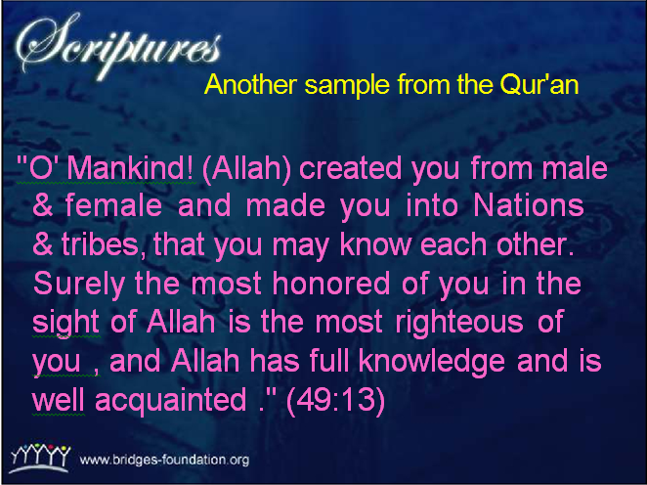

Slide 19


Slide 20
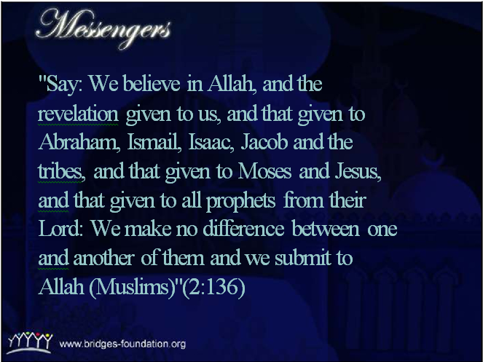

Slide 21
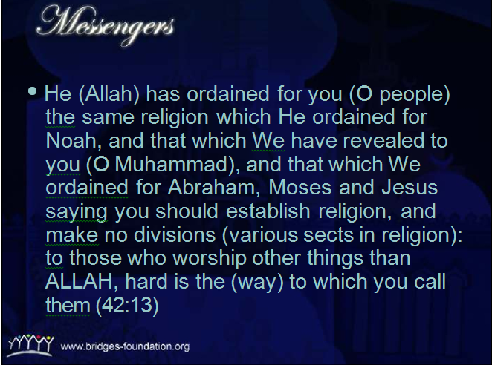
Notes:
That’s why Islam was there since time became immemorial. (see Zakir Naik when Islam began)

Slide 22
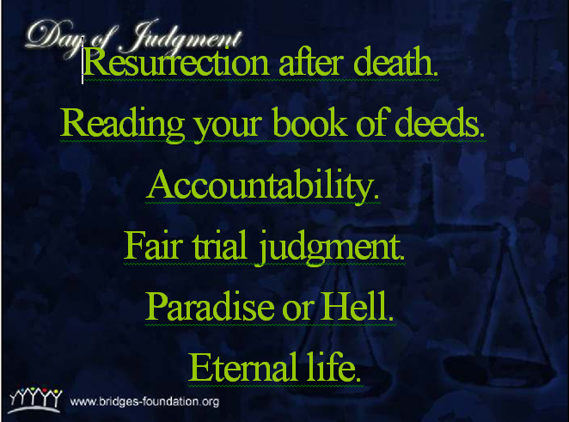

Slide 23

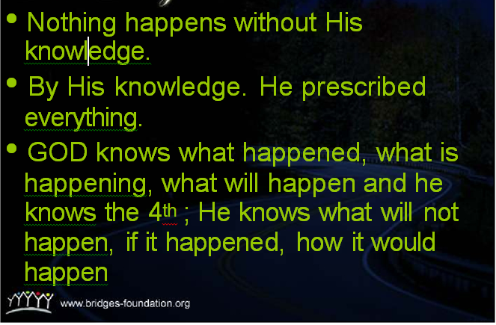

Slide 24
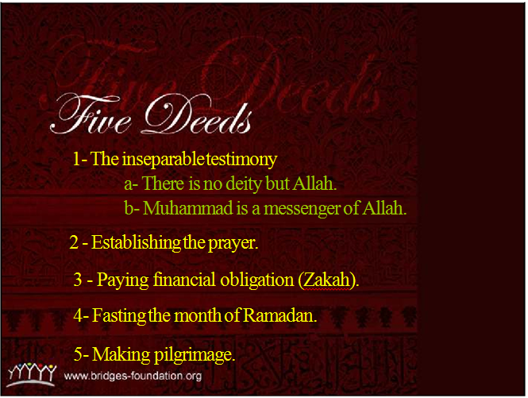

Slide 25
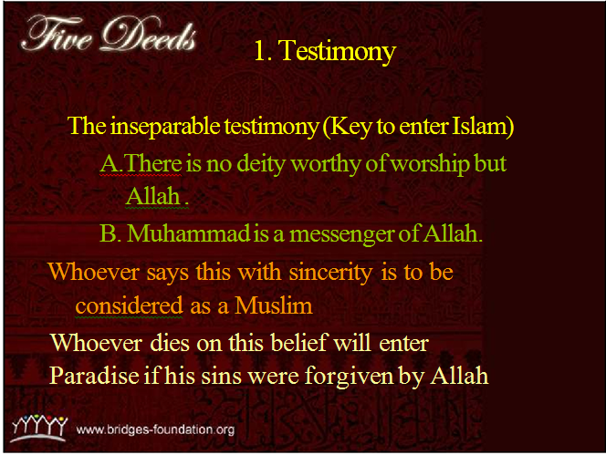

Slide 26
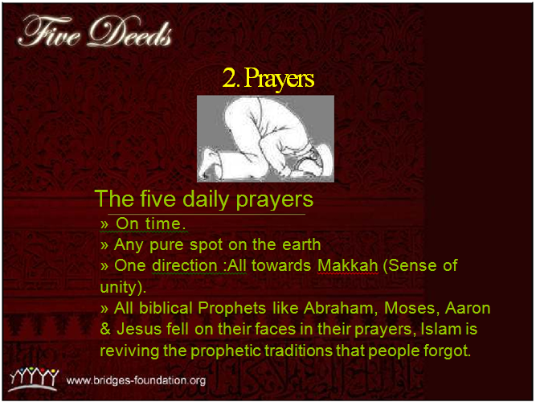

Slide 27
Video

Slide 28
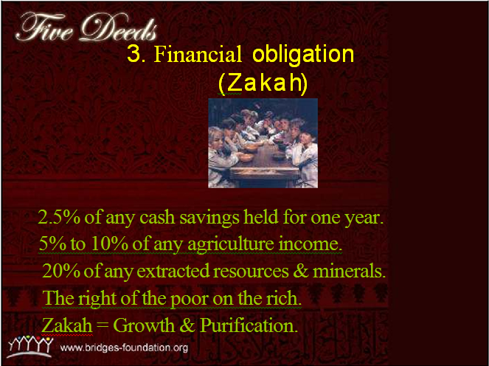

Slide 29
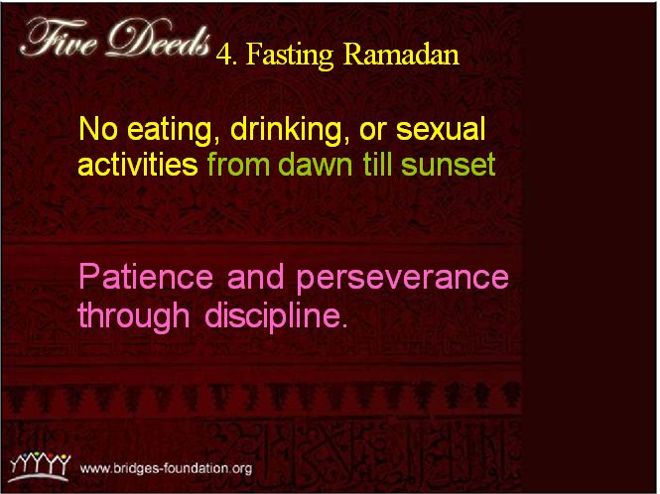

Slide 30
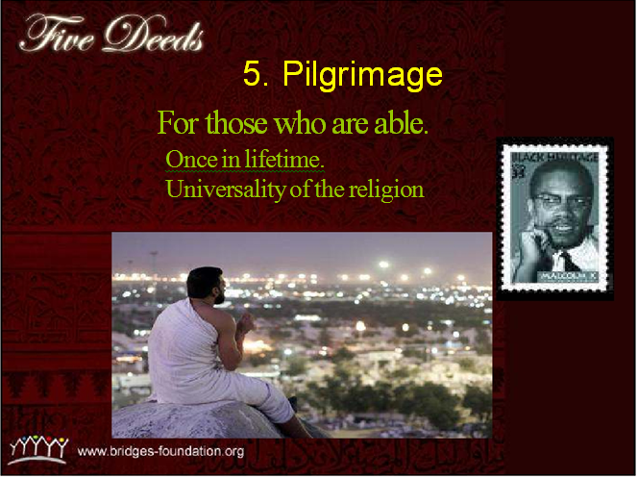

Slide 32
Q & A

Slide 33
DAN discussion
Procedures:
1) A statement will be shown.
2) You have to decide your stance about the statement (Agree, Disagree or Neutral)
3) You may be asked to explain your stance

Slide 34
1. Muhammad was the founder of Islam and Muslims worship him.

Slide 35
2. 50% of the Muslims are Arabs

Slide 36
Country | Number of Muslims
Indonesia | 203 million
Pakistan | 174 million
India | 161 million
Bangladesh | 145 million
Egypt | 79 million
Nigeria | 78 million
Iran | 74 million
Turkey | 74 million
Algeria | 34 million
Morocco | 32 million
Iraq | 30 million
Sudan | 30 million
Afghanistan | 28 million
Ethiopia | 28 million
Uzbekistan | 26 million
Saudi Arabia | 25 million
Yemen | 23 million
China | 22 million
Syria | 20 million
Russia | 16 million
Notes:
Over fifty countries have Muslim-majority populations, while other groups of believers are clustered in minority communities on nearly every continent.
Although Islam is often associated with the Arab world and the Middle East, fewer than 15% of Muslims are Arab.
Countries With The Largest Muslim Populations (2009) from http://islam.about.com/od/muslimcountries/a/population.htm

Slide 37
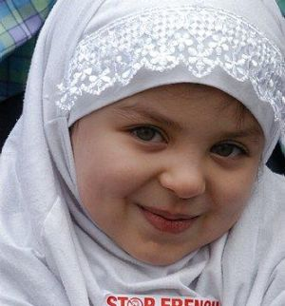
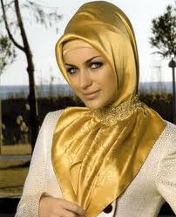
3. Wearing the Hijab is oppressive

Slide 38
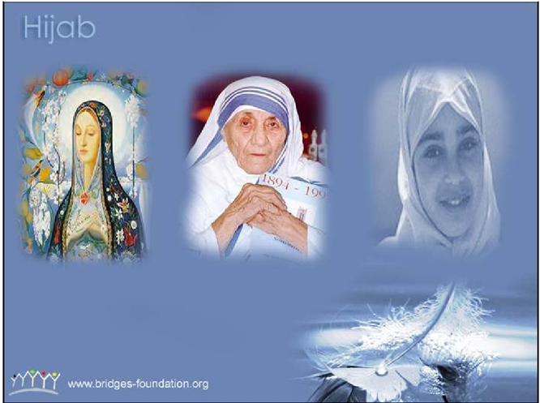

Slide 39
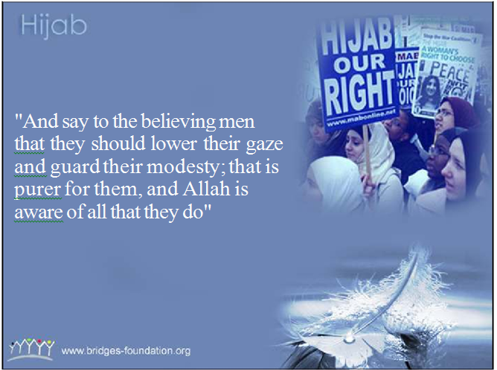

Slide 40


Slide 41


Slide 42
4. Muslims support Jihad

Slide 43
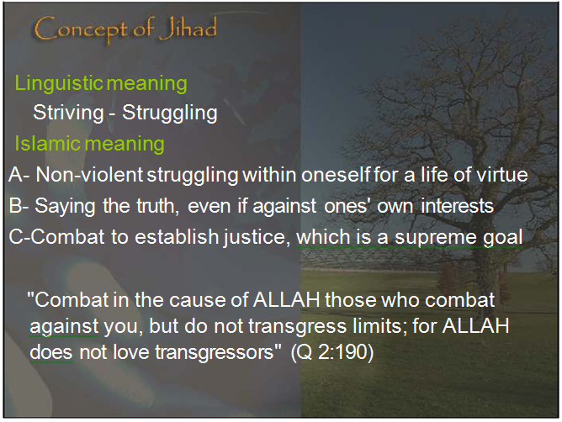
Notes:
Different types of Jihad:
1) Spiritual Jihad
2) Verbal Jihad
3) Combative/physical Jihad

Slide 44
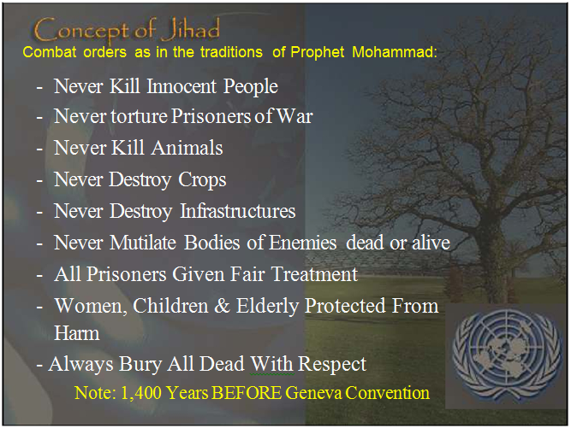

Slide 45
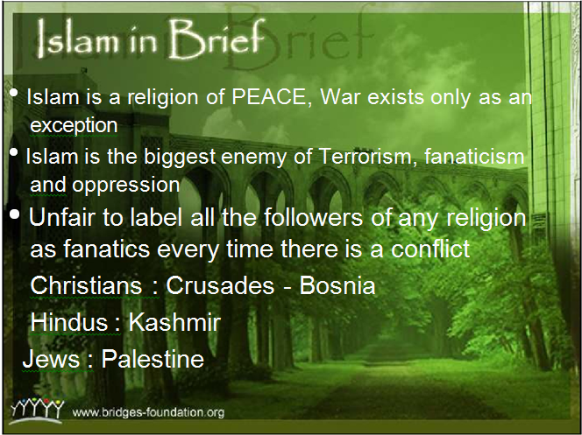

Slide 46
Thank you ☺

