Slide 1
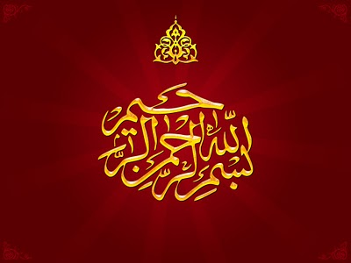

Slide 2

Al
The Last Revelation

Slide 3

وَمَا كَانَ لِبَشَرٍ أَنْ يُكَلِّمَهُ اللَّهُ إِلَّا وَحْيًا أَوْ مِنْ وَرَاءِ حِجَابٍ أَوْ يُرْسِلَ رَسُولًا فَيُوحِيَ بِإِذْنِهِ مَا يَشَاءُ إِنَّهُ عَلِيٌّ حَكِيمٌ
It is not fitting for a man that God should speak to him except by inspiration, or from behind a veil, or by sending of a messenger to reveal with God's permission what God wills: for He is Most High, Most Wise' (42: 51)

Slide 4

Means of revelation are
Inspiration:
e.g. in a dream:, Ibrahim receives guidance in a vision, while asleep, to sacrifice his son (see 37:102)
Speech hidden away:
God spoke to Musa ( Moses ) from the fire (see 27:8)
Words (speech) sent through a special messenger from God:
God sent the Angel Gabriel as the messenger to Muhammad sallallahu alaihe wasallam to reveal His message (see 2:97).

Slide 5
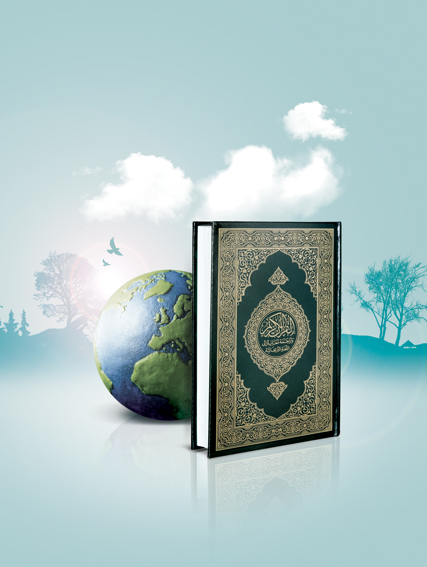
BEGINNING OF THE REVELATION
The revelation of the Qur'an began in the lailat al-qadr of Ramadan (the 27th night or one of the odd nights after the21st) after the Prophet Muhammad
had passed the
fortieth year
of his life
(that is around the year 610), during his seclusion in the cave of Hira' on a mountain near Makka .

Slide 6
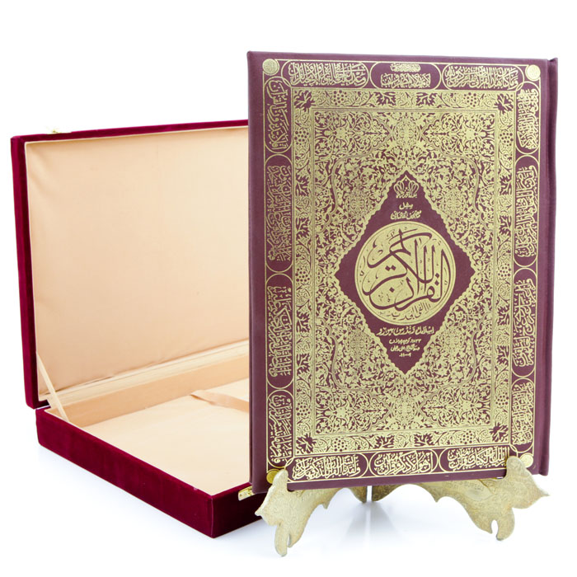
The Holy Qur'an descended in two stages
[al Itqan fi ulum al quran, Beirut, 1973, Vol. I pp. 39-40]
According to Imam Suyuti' on the basis of three reports from 'Abdullah Ibn 'Abbas, in Hakim, Baihaqi and Nasa'i,

Slide 7

1. From the lauh al-mahfuz, (the preserved tablet‘), to the lowest of the heavens (bait al-'izza) of the world, all together, in the laila al-qadr.

Slide 8
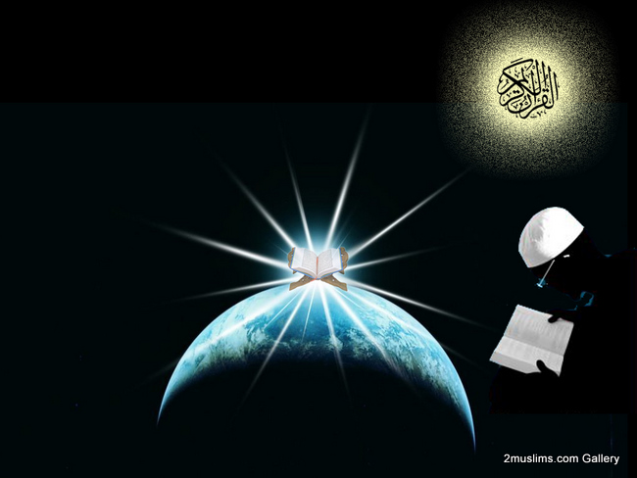
2.From the heavens to earth , in stages throughout the twenty-three years of Muhammad's sallahu alaihe wasallam Prophethood, and first in the lailatul-qadr
of Ramadan,
through
the Angel
Gabriel.

Slide 9

Narrated Aisha the mother of the faithful believers:
The commencement of the divine inspiration to Allah's
Prophet was in the
form of good dreams
which came like
bright daylight
(i.e. true) and
then the love of
seclusion was
bestowed upon him.

Slide 10
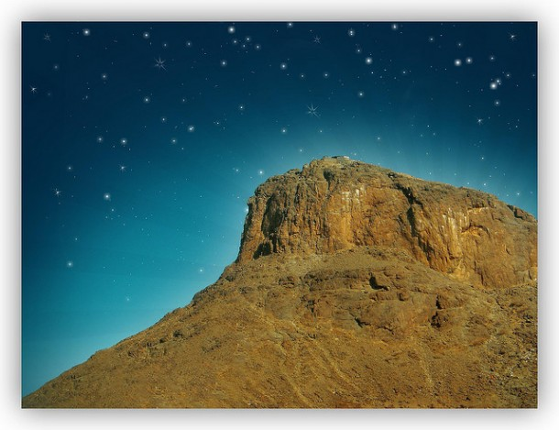
He used to go in seclusion in the Cave of Hira', where he used to worship (Allah alone) continuously for many days before his desire to see his family.
He used to take food with him sufficient for few days and then comeback to (his wife)
Khadija to take food
likewise again, till
suddenly the truth
descended upon
him while
he was
in the
Cave of Hira'.

Slide 11

The angel came to him and asked him to read. The Prophet replied 'I do not know how to read'. The Prophet added, 'The angel caught me (forcibly) and pressed me so hard that I could not bear it anymore. He then released me and again asked me to read and I replied, "I do not know how to read"

Slide 12
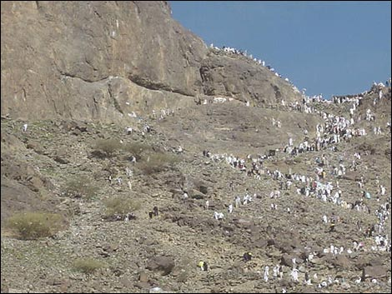
Thereupon he caught me again and pressed me a second time till I could not bear it any more. He then released me and again asked me to read, but again I replied, "I do not know how to read" (or what shall I read?).

Slide 13
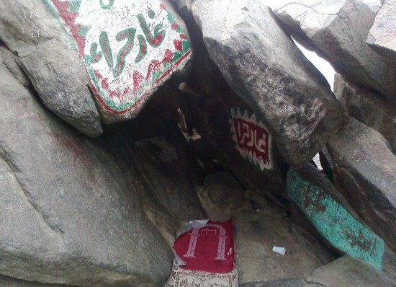
He caught me for the third time and pressed me, and then released me and said:
اقْرَأْ بِاسْمِ رَبِّكَ الَّذِي خَلَقَ () خَلَقَ الْإِنْسَانَ مِنْ عَلَقٍ () اقْرَأْ وَرَبُّكَ الْأَكْرَمُ () الَّذِي عَلَّمَ بِالْقَلَمِ () عَلَّمَ الْإِنْسَانَ مَا لَمْ Oيَعْلَمْ
'Read in the name of your Lord, who created, created man from a clot. Read! And your Lord is most bountiful. (He who taught) the use of the pen taught man which he knew not .‘[Imam Suyuti, Itqan,p.23-4.]

Slide 14
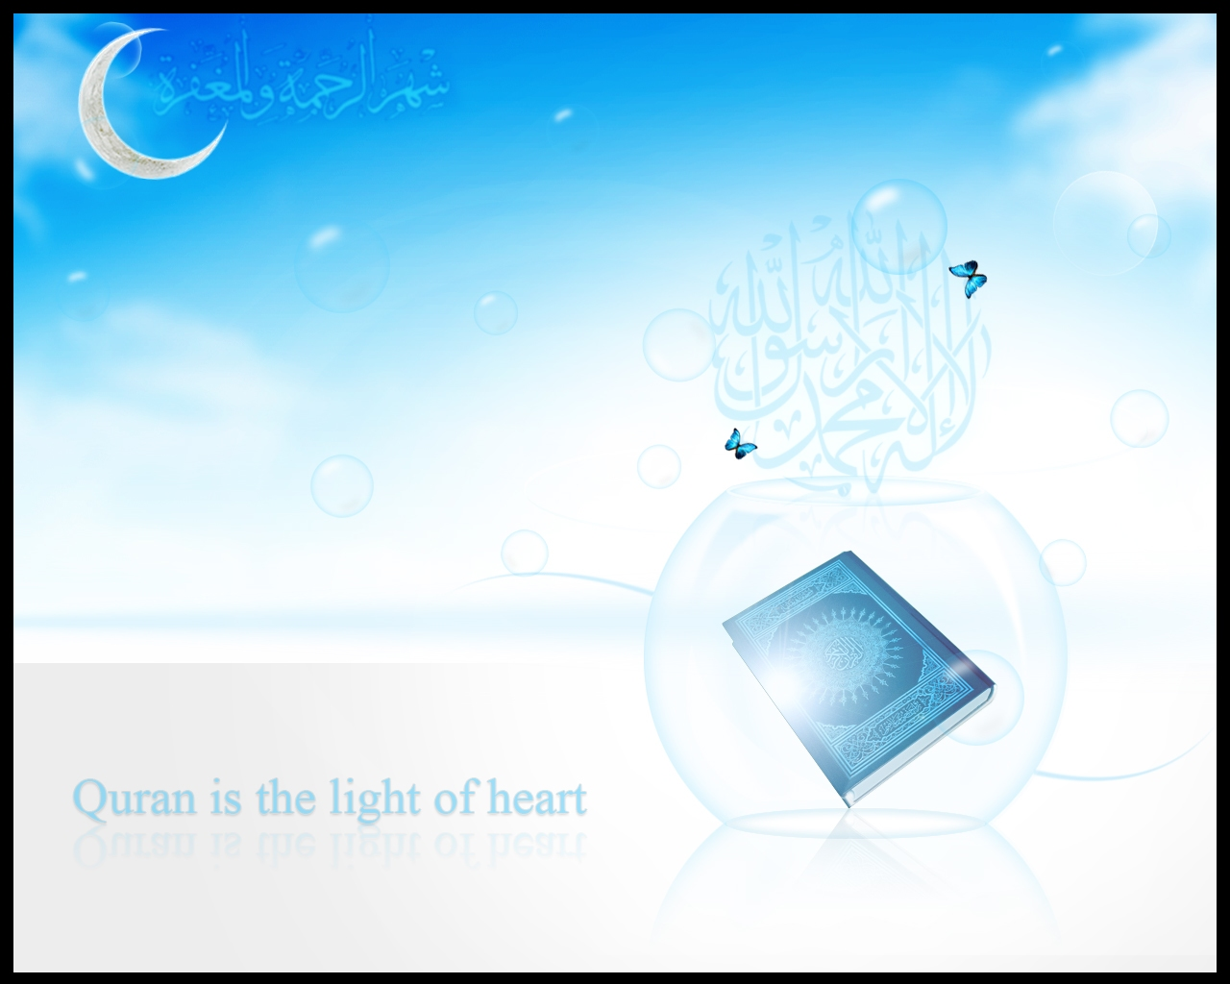
The narration goes on to tell us that the Prophet went back to his wife Khadija and recounted to her his dreadful experience.She comforted him and both of them consulted Waraqa, Khadija's relative and a learned Christian. Waraqa told Muhammad Sallahu alaihe wasallam that he had encountered the one 'whom Allah had sent to Moses' and that he would be driven out by his people.

Slide 15
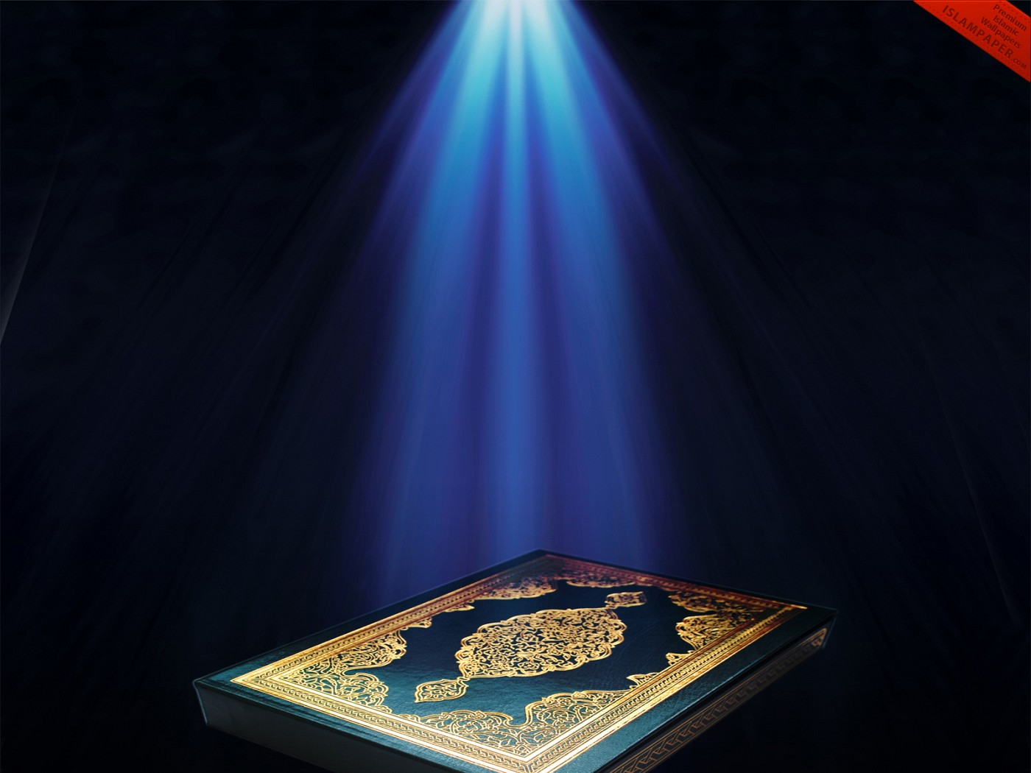
*How Revelation came
Narrated Aisha, the mother of the faithful believers: Al-Harith bin Hisham asked Allah's apostle: 'O Allah's apostle. How is the divine inspiration revealed to you?' Allah's apostle replied, 'Sometimes it is "revealed" like the ringing of a bell, this form of inspiration is the hardest of all and then this state passes off after I have grasped what is inspired. Sometimes the Angel comes in the form of a man and talks to me and I grasp whatever he says'. [Bukhari, I, No. 2.]

Slide 16
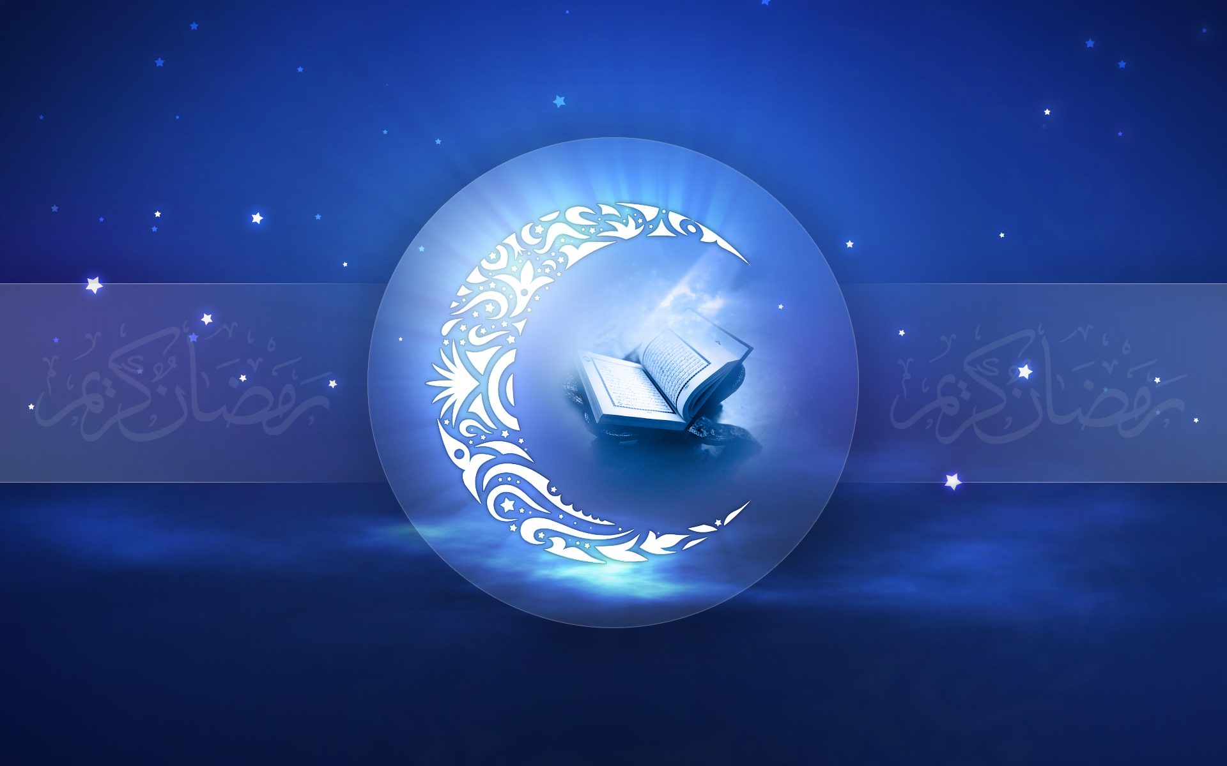
The Pause (fatra)
Hadhrat Jabir bin 'Abdullah Al-Ansari radiallahu anhu narrates once talking about the period of pause in revelation the Prophet said, 'While I was walking, all of a sudden I heard a voice from the heaven. I looked up and saw the same angel who had visited me at the Cave of Hira' sitting on a chair between the sky and the earth.
I got afraid of him and came back home and said "Wrap me (in blankets)" and then Allah revealed the following holy verses (of the Qur'an): O you covered in your cloak, arise and warn (the people against Allah's punishment) [Bukhari, I, end of No. 3.]

Slide 17
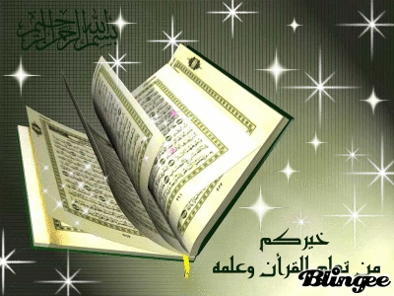
Thereafter
Revelation Resumed Regularly

Slide 18
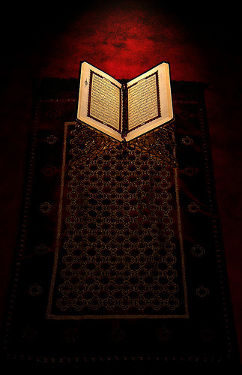
Revelation came to the Prophet (pbuh) throughout his lifetime, both in Makka and Madina, i.e. over a period of approximately 23 years, until shortly before his death in the year 10 after Hijra [immigration] (632).

Slide 19
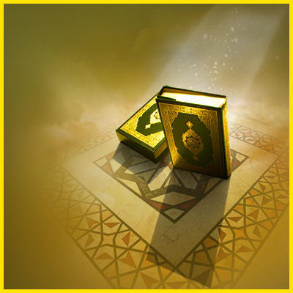
Reasons why the Qur'an was sent down in Stages
The Qur'an was revealed in stages over a period of 23 years, and not as a complete book in one single act of revelation.There are a number of reasons for this; most important are the following:
1.To strengthen the heart of the
Prophet by addressing him
continuously and whenever the
need for guidance arose.
وَقَالَ الَّذِينَ كَفَرُوا لَوْلَا نُزِّلَ عَلَيْهِ الْقُرْآَنُ جُمْلَةً وَاحِدَةً كَذَلِكَ لِنُثَبِّتَ بِهِ فُؤَادَكَ وَرَتَّلْنَاهُ تَرْتِيلًا
And those who disbelieve say: Why has not the Quran been revealed to him all at once? Thus, that We may strengthen your heart by it and We have arranged it well in arranging ( right order ) ( Ch .25 , 32 )

Slide 20

2. Out of consideration for the Prophet since revelation was a very difficult experience for him.
3. To gradually implement the laws of God.
4. To make understanding, application and memorization of the revelation easier for the believers.

Slide 21
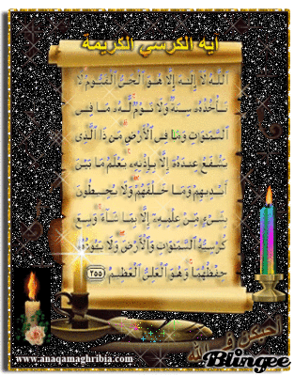
The Preservation Of the Holy Qur’an

Slide 22
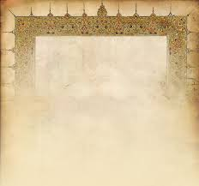
The entire Quran was recorded in writing at the time of revelation from the Prophet’s dictation, by some of his literate companions, the most prominent of them being Zaid ibn Thabit. Others among his noble scribes were Ubayy ibn Ka’b, Ibn Mas’ud, Mu’awiyah ibn Abi-Sufyan, Khalid ibn Al-Waleed and Az-Zubayr ibn Al-Awwam. The verses were recorded on leather, parchment, scapulae (shoulder bones of animals) and the stalks of date palms.

Slide 23

The codification of the Quran (i.e. into a ‘book form’) was done soon after the Battle of Yamamah (11AH/633CE), after the Prophet’s death, during the Caliphate of Abu Bakr radiyallahu anhu. Many companions became martyrs at that battle, and it was feared that unless a written copy of the entire revelation was produced, large parts of the Quran might be lost with the death of those who had memorized it.

Slide 24

Therefore, at the suggestion of Hadhrat Umar radiyallahu anhu to collect the Quran in the form of writing, Zaid ibn Thabit radiallahu anhu was requested by Abu Bakr radiallahu anhu to head a committee which would gather together the scattered recordings of the Quran and prepare a mushaf (loose sheets entire revelation written on it). To safeguard the compilation from errors, the committee accepted only material which had been written down in the presence of the Prophet Muhammad Sallahu alaihe wasallam himself, and which could be verified by at least two reliable witnesses who had actually heard the Prophet Sallahu alaihe wasallam reciting those verses.

Slide 25
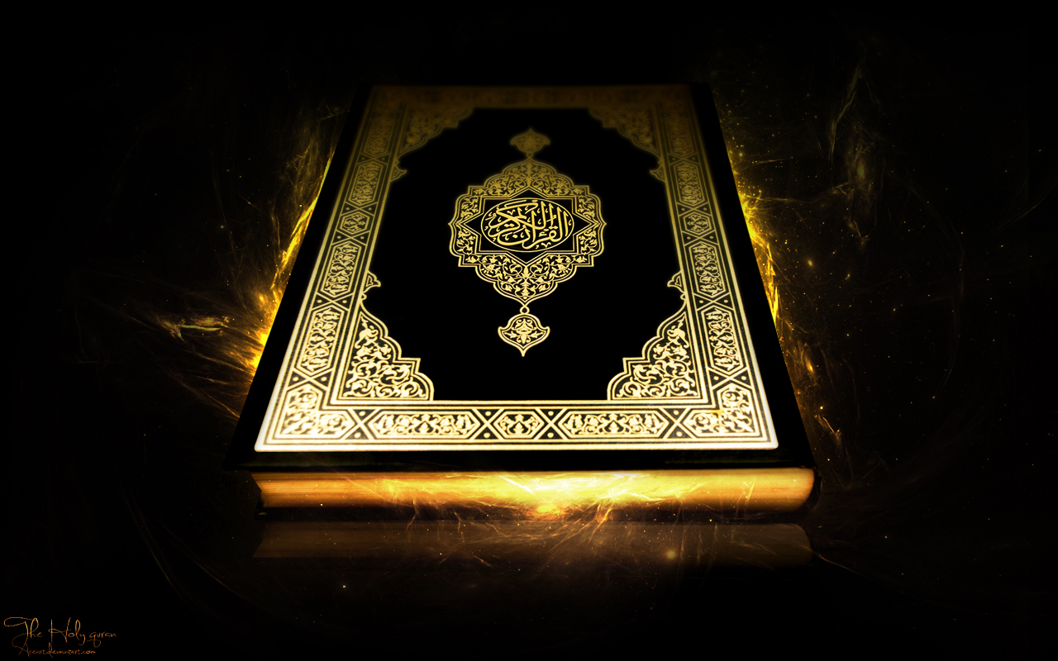
Once completed and unanimously approved of by the Prophet’s Companions, these sheets were kept with the Caliph Abu Bakr (d. 13AH/634CE), then passed on to the Caliph Umar (13-23AH/634-644CE), and then Umar’s daughter and the Prophet’s widow, Hafsah radiyallahu anha.

Slide 26

The third Caliph Uthman radiyallahu anhu(23AH-35AH/644-656CE) requested Hafsah radiyallahu anha to send him the manuscript of the Quran which was in her safekeeping, and ordered the production of several bounded copies of it. This task was entrusted to the Companions Zaid ibn Thabit, Abdullah ibn Az-Zubair, Sa’eed ibn Al-’As, and Abdur- Rahman ibn Al-Harith ibn Hisham. Upon completion (in 25AH/646CE),Hadhrat Uthman returned the original manuscript to Hafsah radiyallahu anha and sent the copies to the major Islamic
provinces.

Slide 27
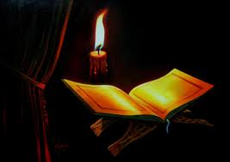
A number of non-Muslim scholars who have studied the issue of the compilation and preservation of the Quran also have stated its authenticity.
John Burton, at the end of his substantial work on the Quran’s compilation, states that the Quran as we have today is:
“…the text which has come down to us in the form in which it was organized and approved by the Prophet…. What we have today in our hands is the mushaf of Muhammad.
(John Burton, The Collection of the Quran, Cambridge: Cambridge University Press, 1977, p.239-40.)

Slide 28

Kenneth Cragg describes the transmission of the Quran from the time of revelation till today as occurring, it is “an unbroken living sequence of devotion.”

Slide 29

The historical credibility of the Quran is further established by the fact that one , of the copies sent out by the Caliph Uthman Radiyallahu anhu is still in existence.
It lies in the Museum of the City of Tashkent in Uzbekistan,Central
Asia.[11] According to Memory of the World Program, UNESCO,
(an arm of the United Nations)
‘it is the definite version, known
as the Mushaf of Uthman.’[12]
[11] Yusuf Ibrahim al-Nur, Ma’ al-Masaahif, Dubai: Dar al-Manar, 1st ed., 1993, p.117; Isma’il Makhdum, Tarikh al-Mushaf al-Uthmani fi Tashqand, Tashkent: Al-Idara al-Diniya, 1971, p.22ff. [12] (http://www.unesco.org.)

Slide 30
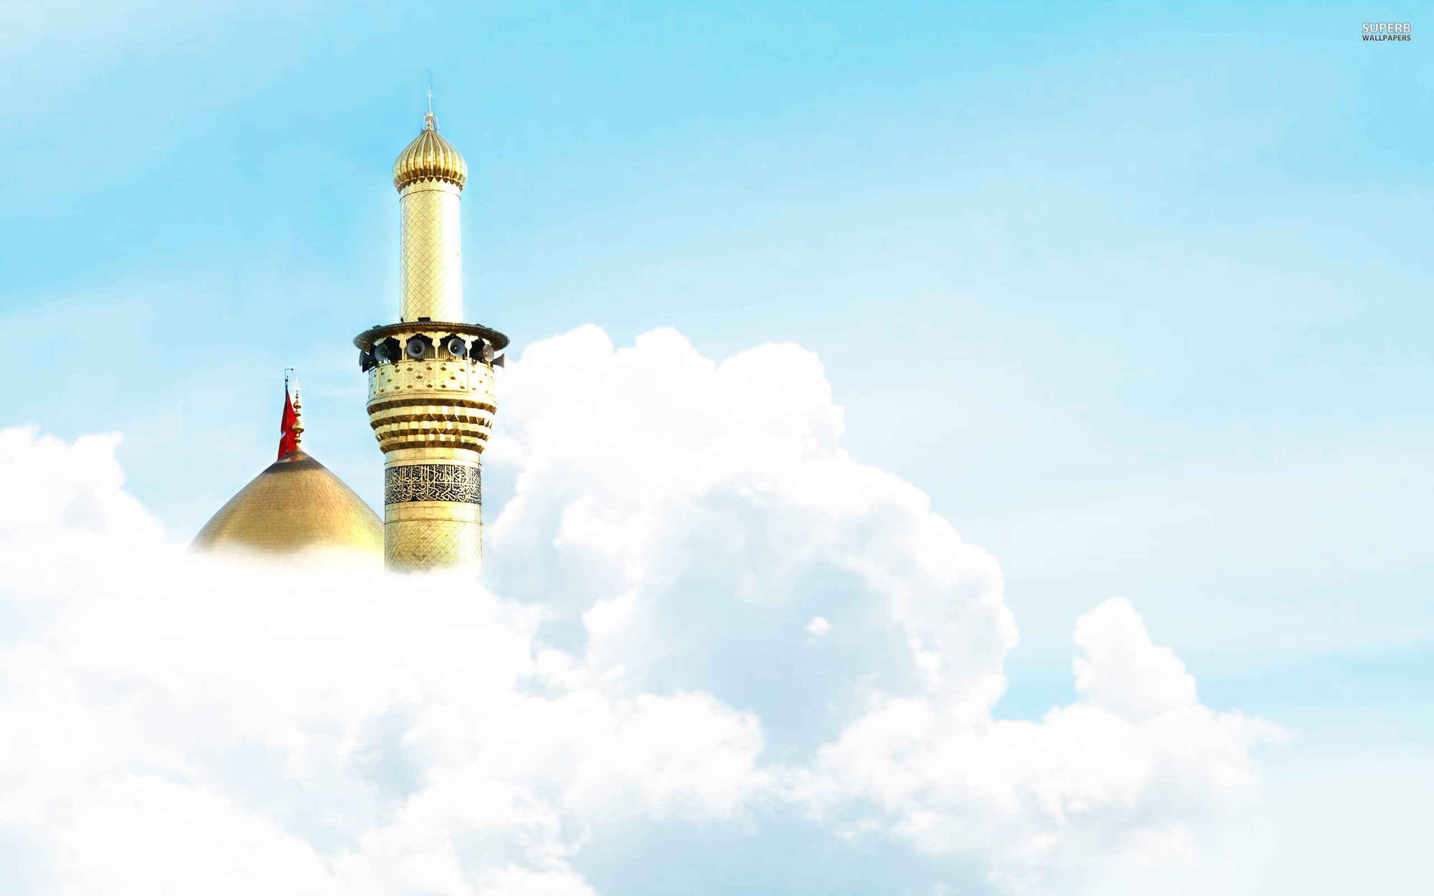
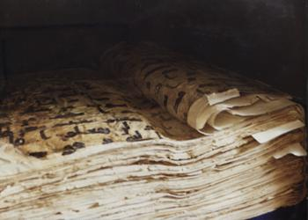
This manuscript, held by the Muslim Board of Uzbekistan, is the earliest written version of the Quran. It is the definite version, known as the Mushaf of uthman.
(Image courtesy of Memory of the World Register, UNESCO.)

Slide 31
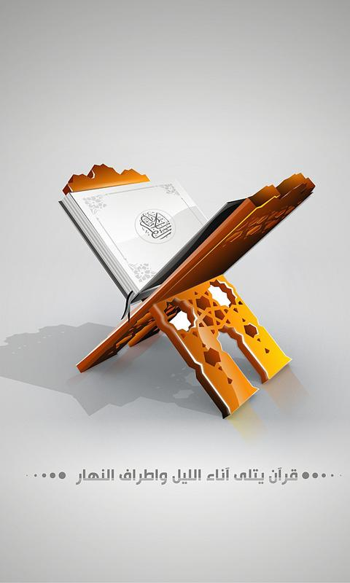
A facsimile of the mushaf in Tashkent is available at the Columbia University Library in the US.[13] This copy is a proof that the text of the Quran we have in circulation today is identical with that of the time of Prophet Muhammad sallallahu alaihe wasallam and his companions.
A copy of the mushaf sent to Syria (duplicated before a fire in 1310AH/1892CE destroyed the Jaami’ Masjid where it was housed) is available in the Topkapi Museum in Istanbul [14] and an early manuscript also exists in Dar al-Kutub as-Sultaniyyah in Egypt .
[13] The Muslim World, 1940, Vol.30, p.357-358 [14] Yusuf Ibrahim al-Nur, Ma’ al-Masaahif, Dubai: Dar al-Manar, 1st ed., 1993, p.113

Slide 32
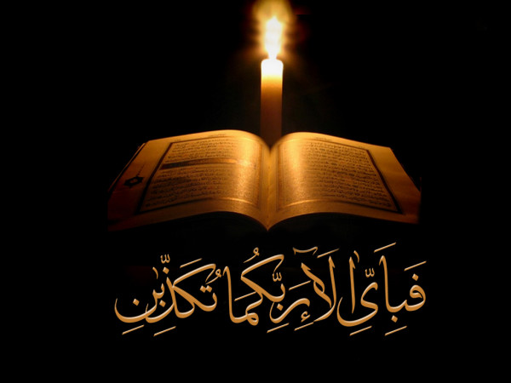
More ancient manuscripts from all periods of Islamic history found in the Library of Congress in Washington, the Chester Beatty Museum in Dublin (Ireland)and the London Museum have been compared with those in Tashkent, Turkey and Egypt, with a result confirming that there have not been any changes in the text from its original time up till today.
(Bilal Philips, Usool at-Tafseer, Sharjah: Dar al-Fatah, 1997, p.157)

Slide 33
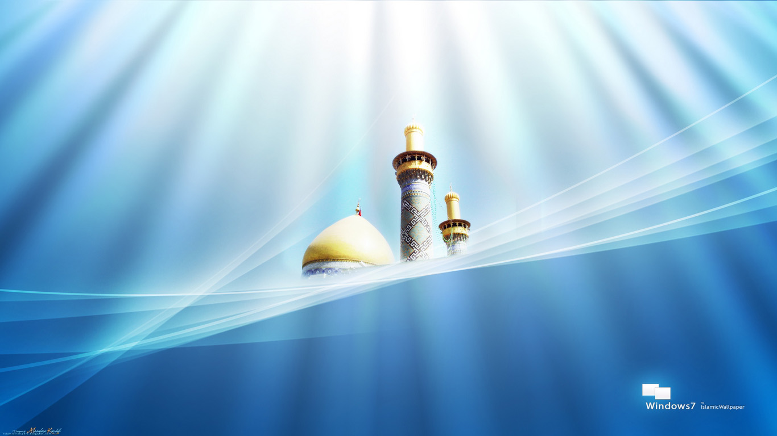
The Institute for Koranforschung, in the University of Munich (Germany), collected over 42,000 complete or incomplete ancient copies of the Quran. After around fifty years of research, they reported that there was no variance between the various copies.
This Institute was unfortunately destroyed by bombs during WWII.
Mohammed Hamidullah, Muhammad Rasullullah, Lahore: Idara-e-Islamiat, n.d., p.179.

Slide 34
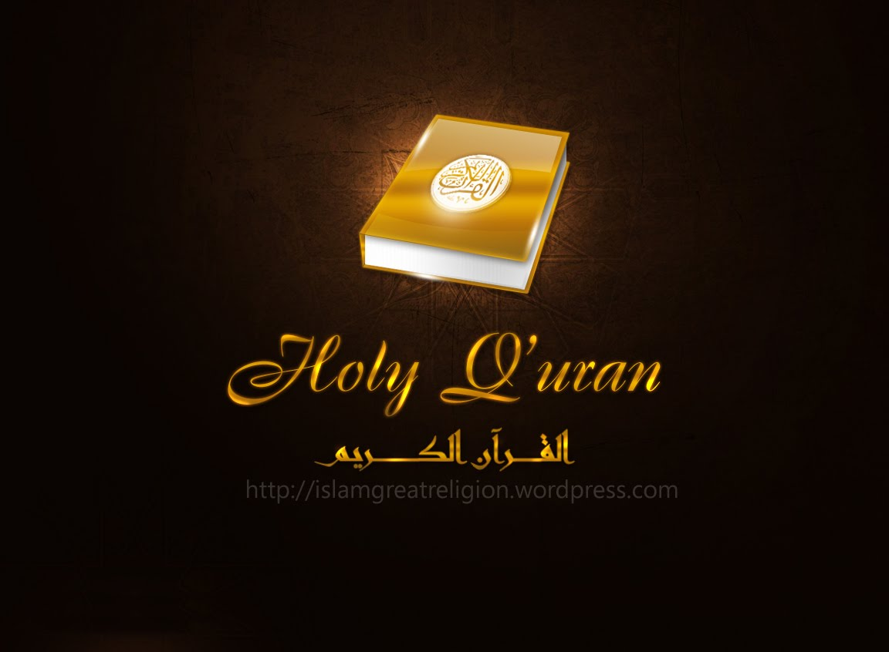
Thus, due to the efforts of the early companions, with God’s assistance, the Quran as we have it today is recited in the same manner as it was revealed. This makes it the only religious scripture that is still completely retained and understood in its original language. Indeed, as Sir William Muir states, “There is probably no other book in the world which has remained twelve centuries (now fourteen) with so pure text.”
Sir William Muir, Life of Mohamet, London, 1894, Vol.1, Introduction.

Slide 35
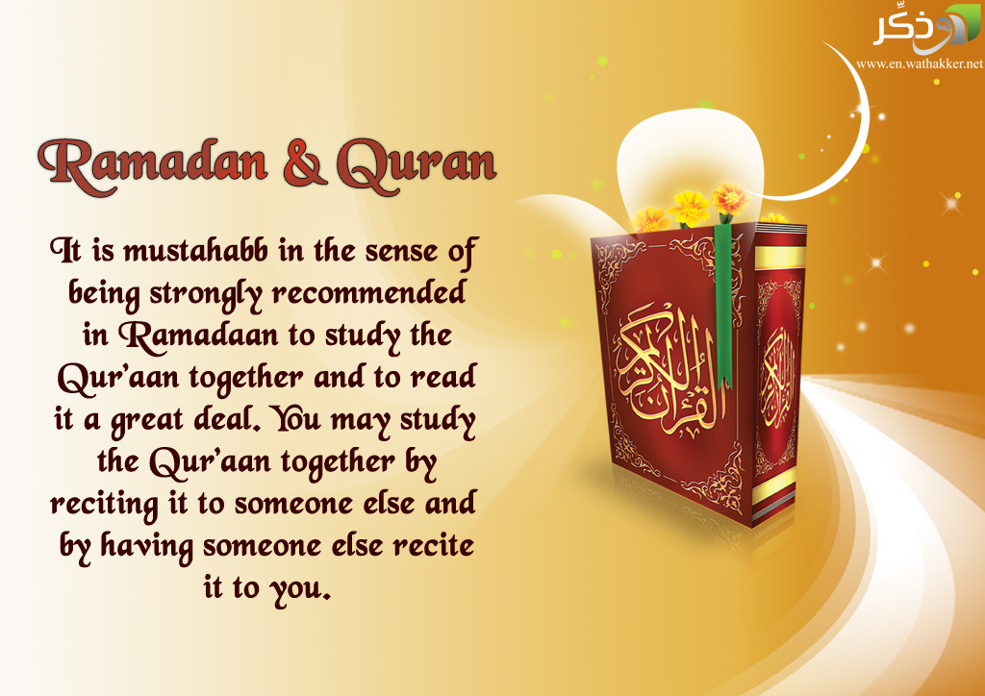
The evidence above confirms God’s promise in the Quran:
“Verily, We have revealed the Reminder, and verily We shall preserve it.” (Quran 15:9)

Slide 36
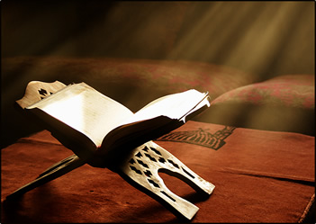
CHARACTERISTIC OF AL QUR’AN
Meaning:
A distinguishing feature of a person or thing

Slide 37
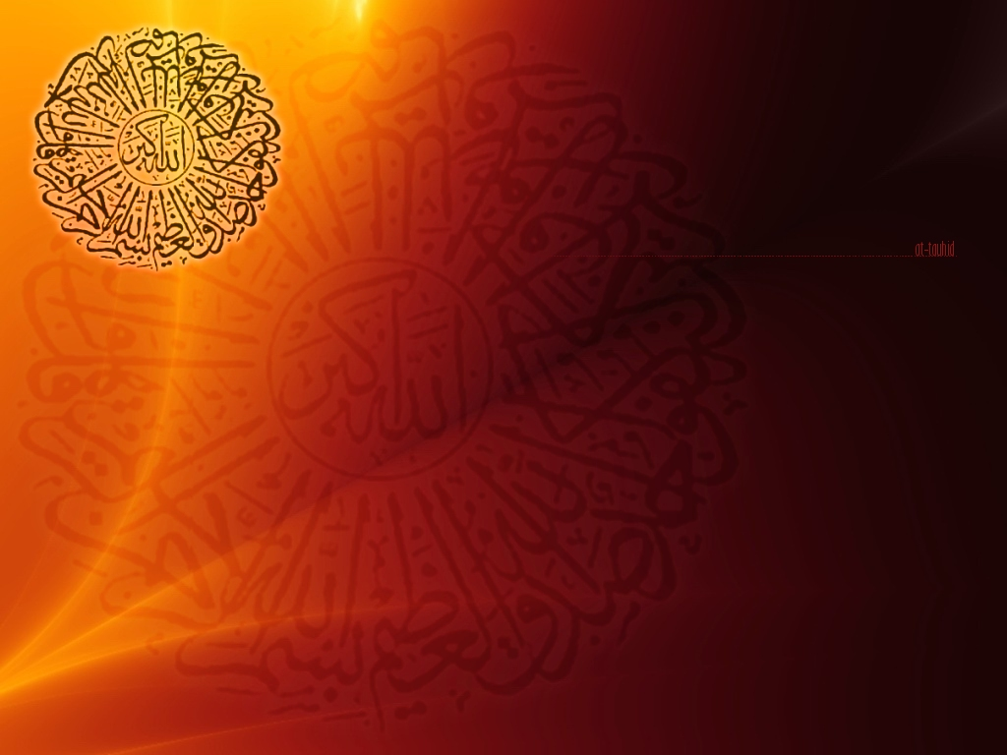
Holy Qur’an is a living Miracle, therefore, every feature of the Qur’an is outstanding and distinguishing as far as Language, meaning , explanation, recitation and Memorization etc. are concerned.
However I will confine myself to only one.
i.e Memorization of Holy Qur’an.

Slide 38
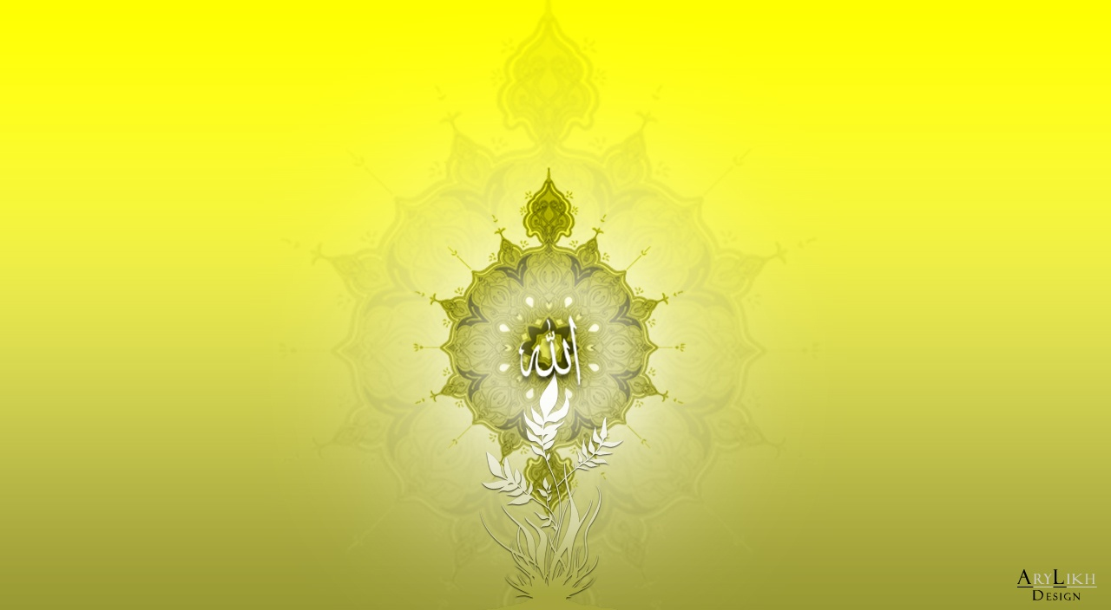
"The Youngest Hafiz-e-Quran In Muslim History Of China"
"Young Boy Reciting Qura
"Fahd al-Kanderi meet Al Maliki (A blind young Qari)

