Slide 1
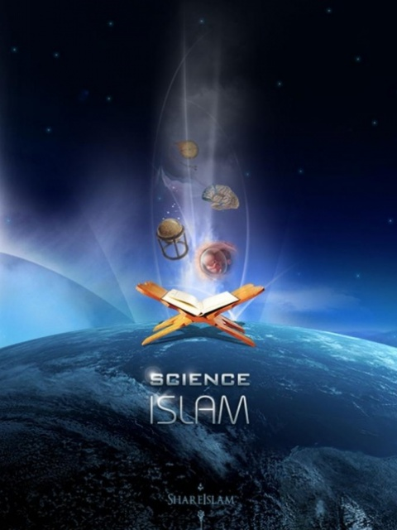

Islam’s Contribution
To World Civilization
Dr. Sabeel Ahmed
GainPeace.com

Slide 2
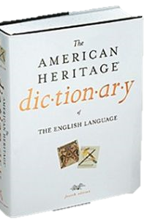
Civilization - Definition
‘An advanced state of intellectual, cultural, and material development in human society, marked by progress in the arts and sciences…’
  American Heritage Dictionary

Slide 3
A more complete definition - Civilization
Technologically advanced
Morally & Ethically advanced

Slide 4
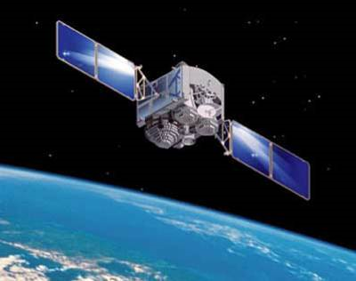
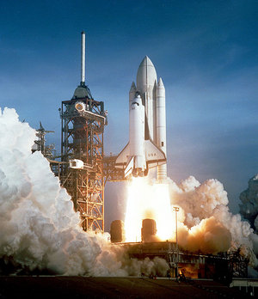
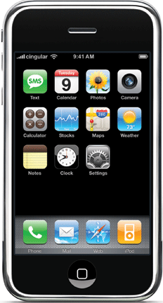
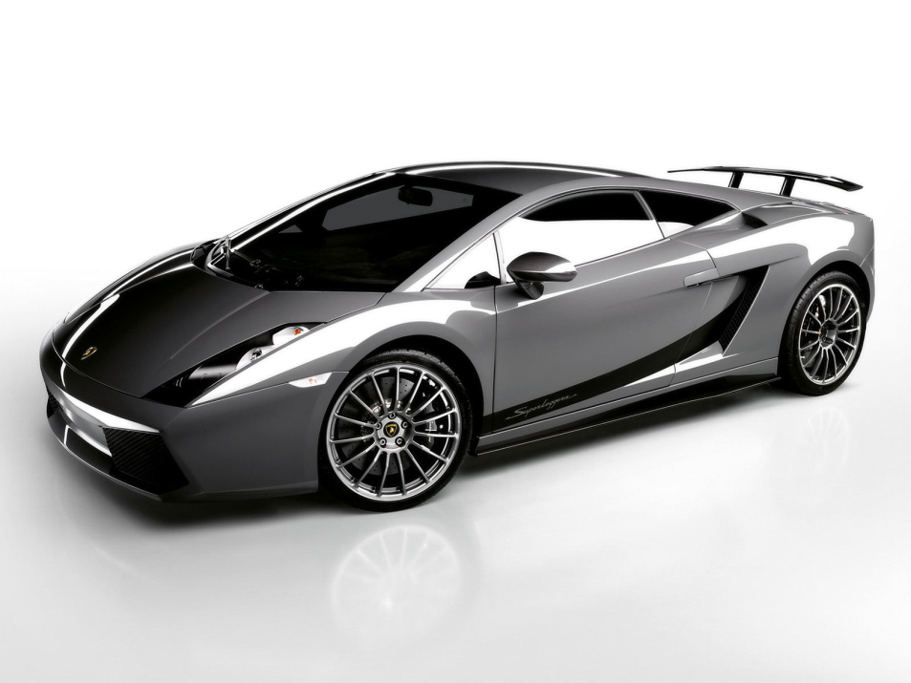
21st Century
21st Century: Built upon the Industrial Revolution

Slide 5
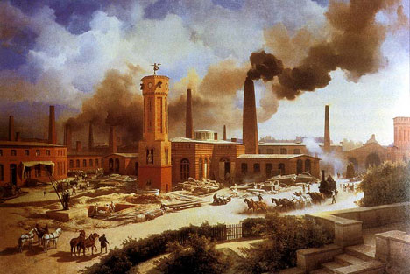
Industrial Revolution
Is built upon…the Renaissance
Notes:
Late 18th – 19th century

Slide 6
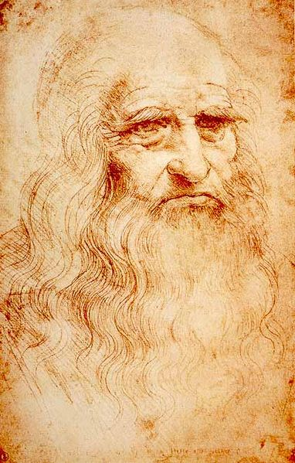
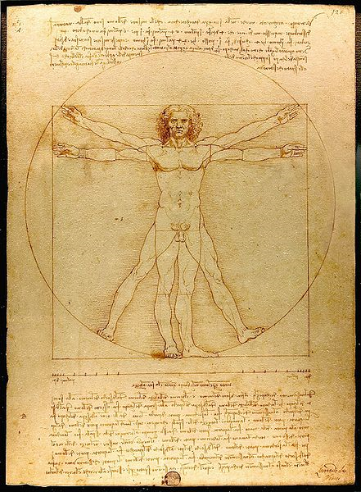
Renaissance
Notes:
Late 14th to 17th century

Slide 7
What Gave Rise to the Renaissance?

Slide 8
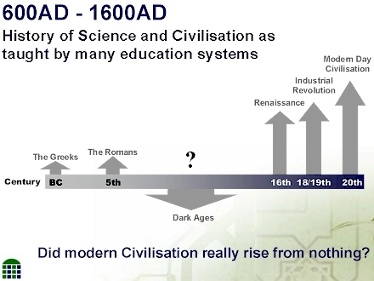

Slide 9
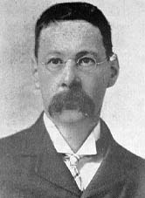
Muslim Civilization helped Renaissance
"It is highly probable that, but for the Arabs (Muslims), modern European civilization would never have arisen at all,"
Sir Thomas Arnold and Alfred Guillaume -"The Legacy of Islam."1997

Slide 10
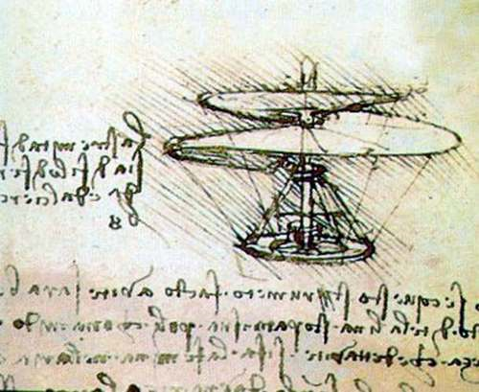
Muslim Civilization helped Renaissance
"It was under the influence of the Arabs and Moorish (Muslim) revival of culture and not in the 15th century, that a real renaissance took place. Spain, not Italy, was the cradle of the rebirth of Europe.
Robert Briffault in the "Making of Humanity"

Slide 11
Why Muslim Achievements are being Ignored?

Slide 12
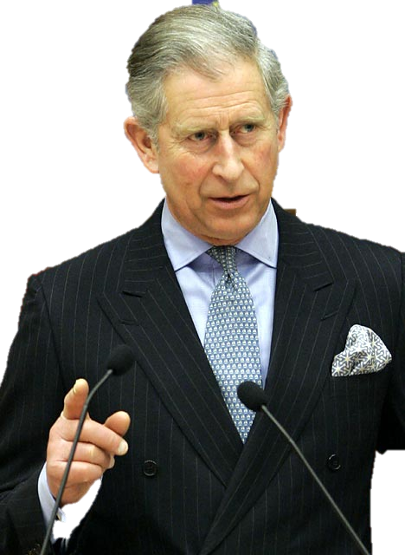
Prince
Charles

Slide 13
Prince Charles
Oxford University
“...because we have tended to see Islam as the enemy of the West, as an alien culture, society, and system of belief, we have tended to ignore or erase its great relevance to our own history.”

Slide 14
What factors motivated the Muslim Civilization?

Slide 15
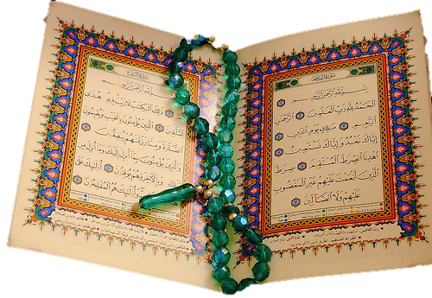
Factors Motivating Muslims
To Research, Invent & Enlight the world
The Quran
Life of
Prophet Muhammad
(peace be upon him)

Slide 16
Quran’s encouragement to seek knowledge
First word revealed in the Quran = Read (Iqra)
  750 + verses in the Quran that encourages humans to: Ponder, think, contemplate, reflect, research…

Slide 17
Quran – Reflect…
  They ask you about intoxicants and gambling: say, "In them there is a gross sin, and some benefits for the people. But their sinfulness far outweighs their benefit." They also ask you what to give to charity: say, "The excess." God thus clarifies the revelations for you, that you may reflect
  Quran (2.219)

Slide 18
Quran - Ponder
Say, `Ponder over what is happening in the heavens and the earth.'
(Quran 10:101)

Slide 19
Quran - Think
Those who remember Allah (always, and in prayers) standing, sitting, and lying down on their sides, and think deeply about the creation of the heavens and the earth…’
(Quran 3.191)

Slide 20
Prophet Muhammad Said:
(Peace be upon him)
“The seeking of knowledge is obligatory for every Muslim…”
(Al-Tirmidhi Hadith 218)

Slide 21
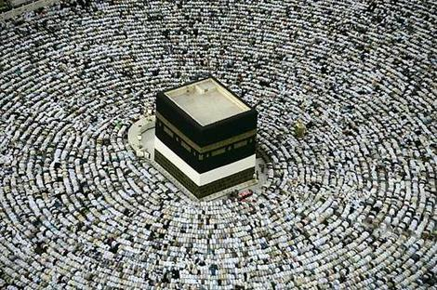
Necessity for Muslims to Develop new Technology
As Muslims started to migrate to different region, they need to accurately find the direction towards Makkah, Saudi Arabic.
They developed scientific instruments to fulfill this need.
Direction of Makkah during Prayer

Slide 22
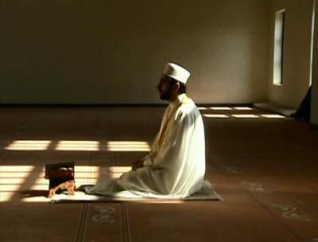
Solar Calendar
Calculate the times of the 5 prayers
As Muslims started to migrate to different region, they need to accurately calculate the TIMES of the 5 daily prayers.
They developed scientific instruments to fulfill this need.

Slide 23
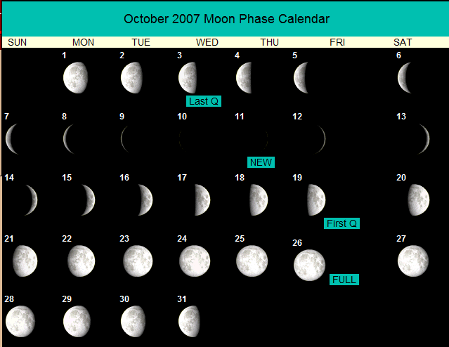
Lunar Calendar
To calculate the start of Islamic months

Slide 24
Speaking on Muslim Contributions..
Extreme sides are taken
  Total exclusion of Muslim contributions in Western textbooks
  All inventions were made by Muslims

Slide 25
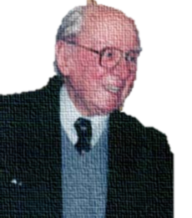
Middle Ground
"Because Europe was reacting against Islam, it belittled the influence of Saracens [Muslims] and exaggerated its dependence on its Greek and Roman heritage. So today an important task for us is to correct this false emphasis and to acknowledge fully our debt to the Arab and Islamic world"
(W. Montgomery Watt, Islamic Surveys: The Influence of Islam on Medieval Europe; Edinburgh, England; 1972; p.84).

Slide 26
Human Civilization
Western
Chinese
Islamic
Greek
Persian
Roman
Byzantine
Indian

Slide 27
Human Civilization
Language
Religions
Social Customs
Architecture
Science and Innovations
Cuisine
Transportation
Industry and Agriculture

Slide 28
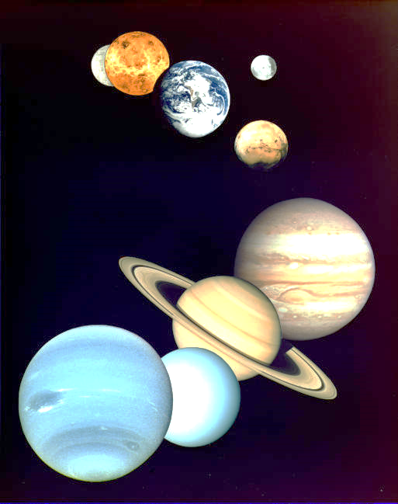
Astronomy

Slide 29
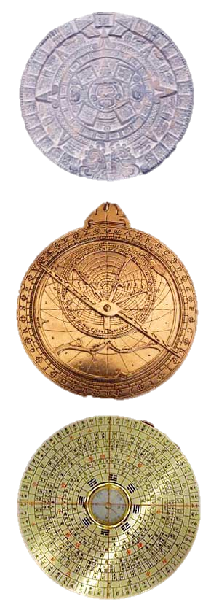
The Astrolabe: It was used to chart the precise time of sunrises and sunsets, and to determine the period for fasting during the month of Ramadan. Also to calculate the distances between the various planets and stars.
Navigational tools: Compass and Astrolabe. Enabled long journey navigation. Eventually discovery of the new world.
Al-Biruni, (973 CE) discussed the possibility of the earth’s rotation on its own axis – a theory proven by Galileo six centuries later.

Slide 30
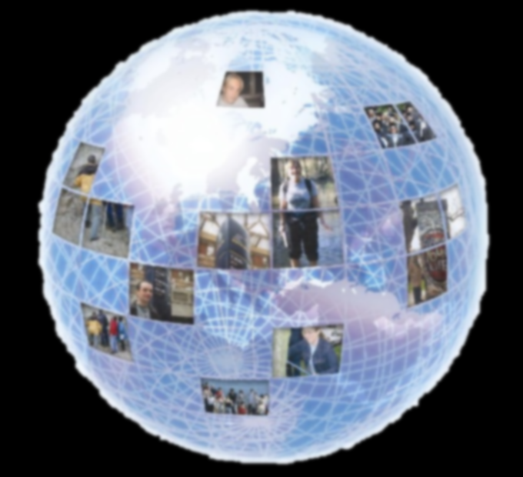
Geography

Slide 31
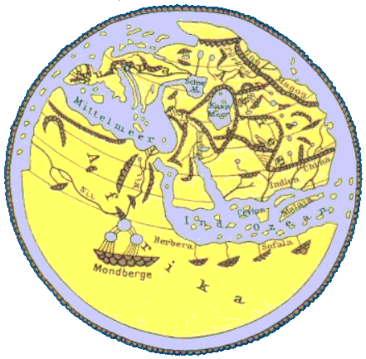
‘The compilation of Al-Idrisi marks an era in the history of science… (Idrisis’s) descriptions of many parts of the earth are still authoritative. For three centuries geographers copied his maps without alteration. The relative position of the lakes which form the Nile, as delineated in his work, does not differ greatly from that established by Baker and Stanley more than seven hundred years afterwards…’
[S. P. Scott (1904), History of the Moorish Empire, pp. 461-2]
Al-Idrisi
1100 CE

Slide 32
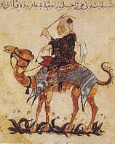
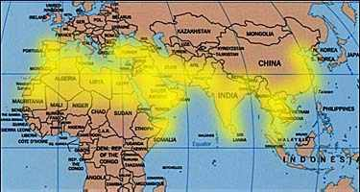
Navigation & Geography
Ibn Battuta (1304-1369 CE), an Arab, covered over seventy five thousand miles.
His wanderings, over a period of decades at a time, took him to Turkey, Bulgaria, Russia, Persia, and central Asia.
He spent several years in India, and from there was appointed ambassador to the emperor of China.
Ibn Battuta’s book, Rihla (journey), is filled with information on the politics, social conditions, and economics of the places he visited.

Slide 33
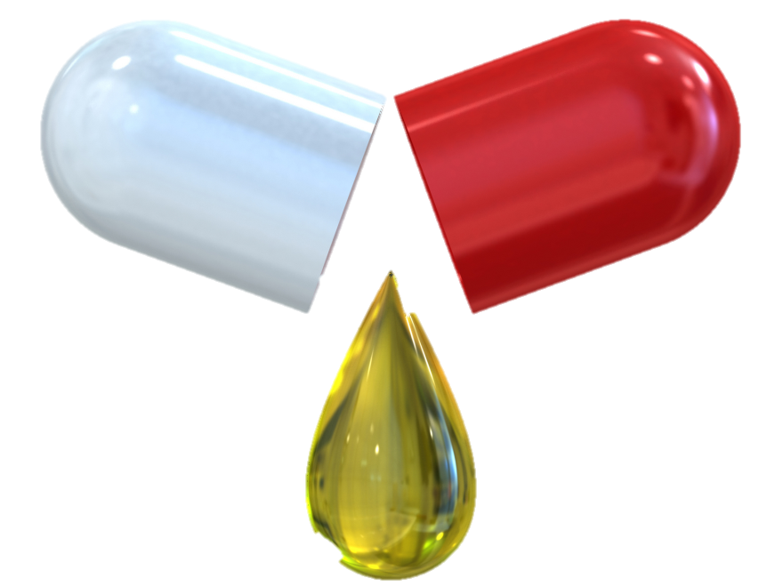
Medical Sciences
Notes:
The purpose of this presentation is not to boost that we are better than you or to put any other civilization, nation or race down, but just to share the great accomplishment that Muslims also provided to the world civilization.
The Renaissance gave rise to the industrial revolution and the industrial revolution eventually gave rise to the modern technological age that we are living in. But what gave rise to the Renaissance?

Slide 34
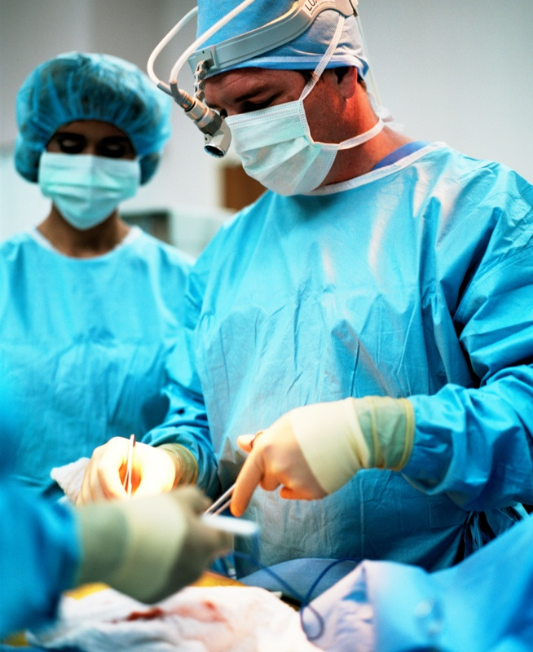
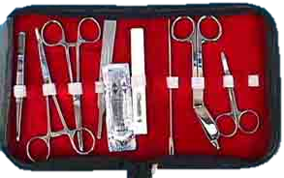
Abu al-Qasim al-Zahrawi – 11th century Spain
Father of Modern Surgery
Invented many of the surgical instruments still used today

Slide 35
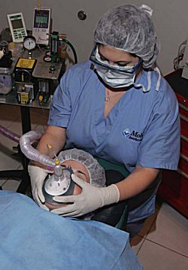
Abu al-Qasim al-Zahrawi – 11th century spain
Father of Modern Surgery
1) The use of anesthesia in surgery.
2) The cauterizing of wounds.
3) The discovery that epidemics arise from contagion through touch and air.

Slide 36
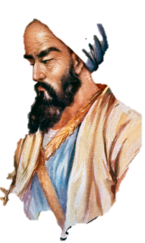

Ar-Razi – 9th Century
Father of Pediatrics
  First to differentiate smallpox from measles and chickenpox in his Kitab fi al-jadari wa-al-hasbah (The Book of Smallpox and Measles).
    Harminder S. Dua, Ahmad Muneer Otri, Arun D. Singh (2008), "Abu Bakr Razi", British Journal of Ophthalmology (BMJ Group) 92: 1324
  Wrote: The Diseases of Children, the first book to deal with pediatrics as an independent field of medicine
    David W. Tschanz, PhD (2003), "Arab Roots of European Medicine", Heart Views 4 (2).

Slide 37
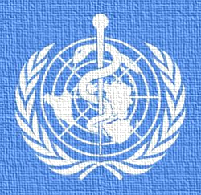
Ar-Razi – 9th Century
Father of Pediatrics
“His writings on smallpox and measles show originality and accuracy, and his essay on infectious diseases was the first scientific treatise on the subject." –
[The Bulletin of the World Health Organization (May 1970)]

Slide 38
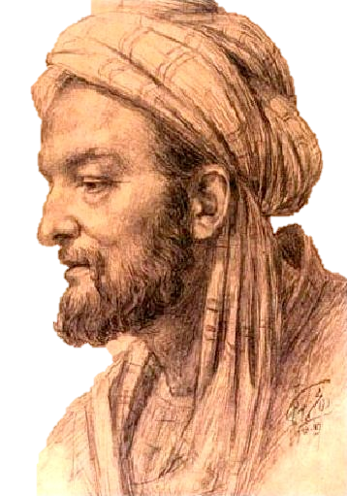
Ibn Sina – 980 CE
Father of Medicine
Father of Clinical Pharmacology
Father of Medicine
  Cas Lek Cesk (1980). "The father of medicine, Avicenna, in our science and culture: Abu Ali ibn Sina (980-1037)", Becka J. 119 (1), p. 17-23.
Father of Clinical Pharmacology
  D. Craig Brater and Walter J. Daly (2000), "Clinical pharmacology in the Middle Ages: Principles that presage the 21st century", Clinical Pharmacology & Therapeutics 67 (5), p. 447-450 [448-449].

Slide 39
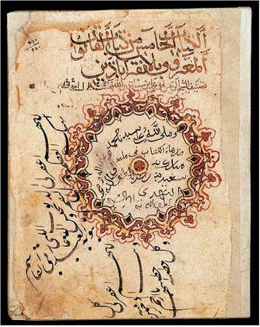
Ibn Sina
The Canon of Medicine
The Canon of Medicine (Al-Qānūn fī al-ṭibb) is the most famous single book in the history of medicine in both East and West.
  (Encyclopedia Britannica)
Used by Medical Schools in East and West for 500 years

Slide 40
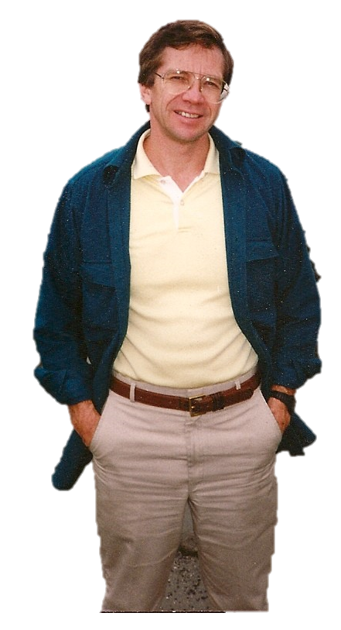
Ibn Sina
The Canon of Medicine
The Canon of Medicine was the first book dealing with evidence-based medicine, experimental medicine clinical trials, randomized controlled trials, efficacy tests, risk factor analysis, and the idea of a syndrome in the diagnosis of specific diseases.
  [Huff, Toby (2003), The Rise of Early Modern Science: Islam, China, and the West, Cambridge University Press, p. 218, ISBN 0521529948]
Toby E. Huff

Slide 41
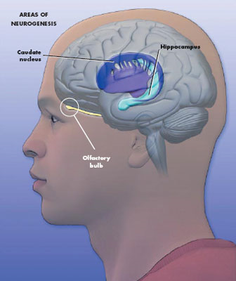
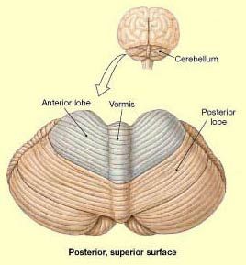
Ibn Sina
Discovered…
Cerebellar vermis—which he named "vermis"—
and the Caudate Nucleus
Professor Dr. İbrahim Hakkı Aydin (2001), "Avicenna And Modern Neurological Sciences", Journal of Academic Researches in Religious Sciences 1 (2): 1-4.

Slide 42
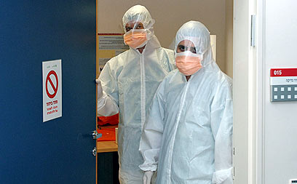
Ibn Sina
Contagious Diseases…
Hospitals starts to have separate wards to isolate patients of contagious diseases
  Medicine And Health, "Rise and Spread of Islam 622-1500: Science, Technology, Health", World Eras, Thomson Gale.

Slide 43
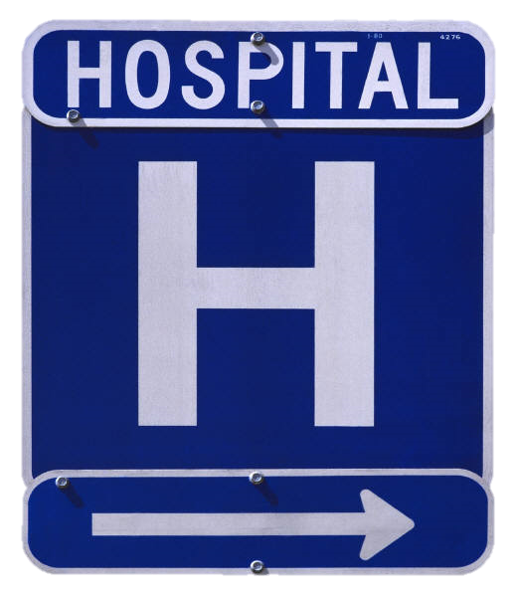
Hospitals

Slide 44
Ancient ‘Hospitals’ – healing places
Ancient healing places:
  healing temples, sleep temples, hospices, asylums, lazarets and leper-houses, all of which in ancient times were more concerned with isolating the sick and the mad from society
  Micheau, Francoise, "The Scientific Institutions in the Medieval Near East", pp. 991–2 , in (Morelon & Rashed 1996, pp. 985-1007)

Slide 45
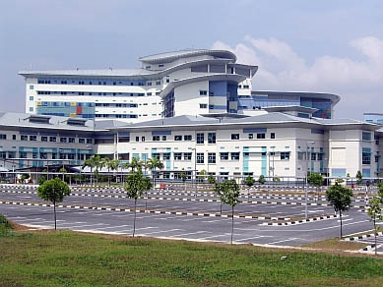
First True Hospitals
Built by Muslims

Slide 46

Public Hospitals
Built by Muslims – 1000 yrs ago
Free for all
Separate sections for males and females
Hospital clothes
Specialized units
  Internal medicine
  Orthopedics
  Ophthalmology
  Psychiatry
Physicians in every specialty – on duty – all shifts
Nurses
Assistants

Slide 47
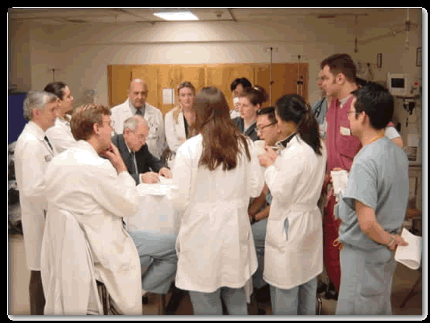
Residency Program
Introduced by Muslims

Slide 48
Doctors – Residency program
Special training for all doctors before starting of practice
Need to pass formal, oral exam in front of specialists
Need to obtain license before practice
913 CE – Baghdad – Caliph al-Muqaddir
  Re-examined – re-certified all doctors in the city due to one medical error, that killed a patient.

Slide 49
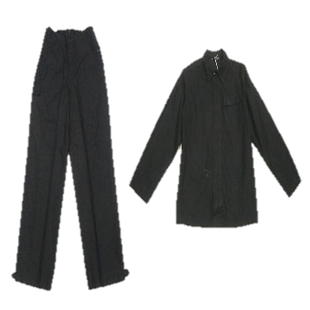
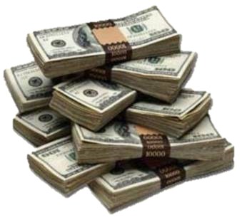
When leaving hospital
New set of clothes were given
FREE Money
  until patients becomes better and start working

Slide 50

Al-Adadi Hospital
Baghdad – 981 CE
Ar-Razi
  Placed pieces of meats in different locations
  Place where meat remained the freshest = built hospital
    Pharmacy
    Library
    Stores
    Garden with fruits and vegetables

Slide 51
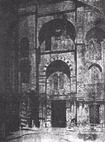
Al-Mansouri Hospital -
Cairo – 1248 CE
8000 Beds
Specialized Wards
Free for all
No limit for inpatient stay
Physicians held accountable for negligence
Physicians only get paid if patients were properly treated or cured.

Slide 52
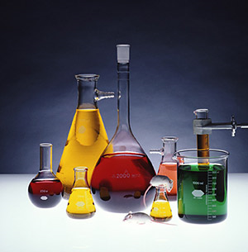
Chemistry

Slide 53
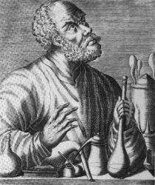
Jabir Ibn Haiyan - 721-815 CE
Father of Chemistry
Invented
25 + laboratory instruments.
Discovered Acids
  Sulfuric acid
  Hydrochloric acid
  Nitric acid
Discovered elements
  Arsenic
  Antimony
  Bismuth

Slide 54

Sociology

Slide 55

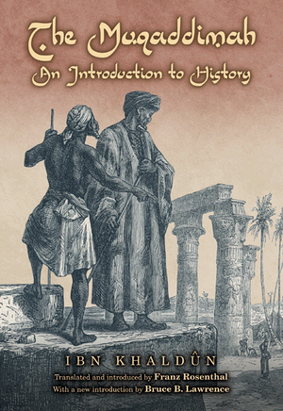
Ibn – Khaldun – 1332-1406
Father of Modern Sociology
Al-Muqaddamah - An Introduction to History
“Undoubtedly the greatest work of its kind that has ever been created by any mind in any time and any place…the most comprehensive and illuminating analysis of how human affairs work that has been made anywhere”.
[Arnold J Toynbee Observer]

Slide 56
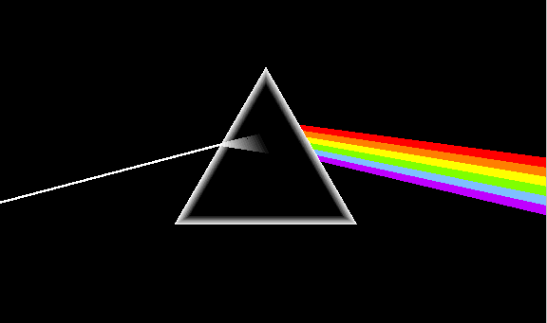
Physics

Slide 57

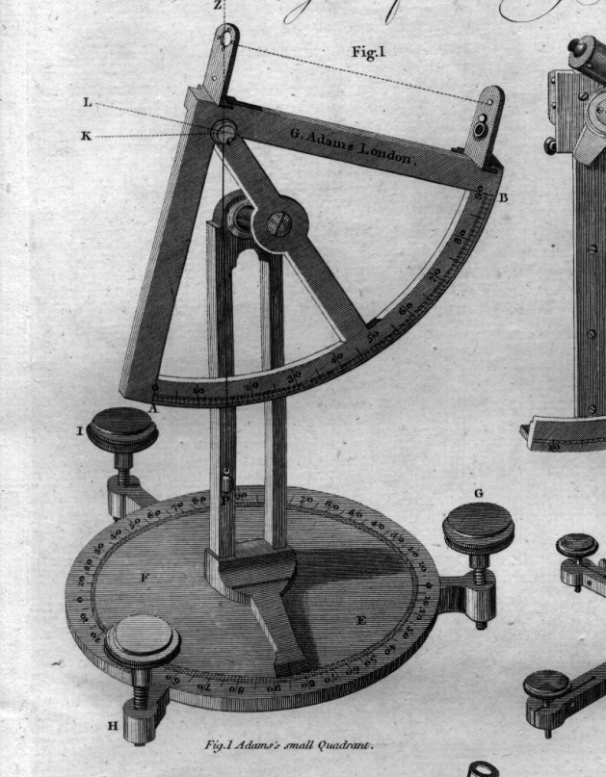
Ibn al-Haytham 965-1039 CE
Founder of Optics
Study of Light
Wrote - Book of Optics
Ranked with Newton’s Philosophiae Naturalis Principia Mathematica as the most influential book on Physics
Pioneer of the modern scientific method

Slide 58

Ibn Haythan
Formulated: Scientific Method
Scientific Method
Observation
Statement of problem
Formulation of hypothesis
Testing of hypothesis using experimentation
Analysis of experimental results
Interpretation of data and
Formulation of conclusion
Publication of findings

Slide 59
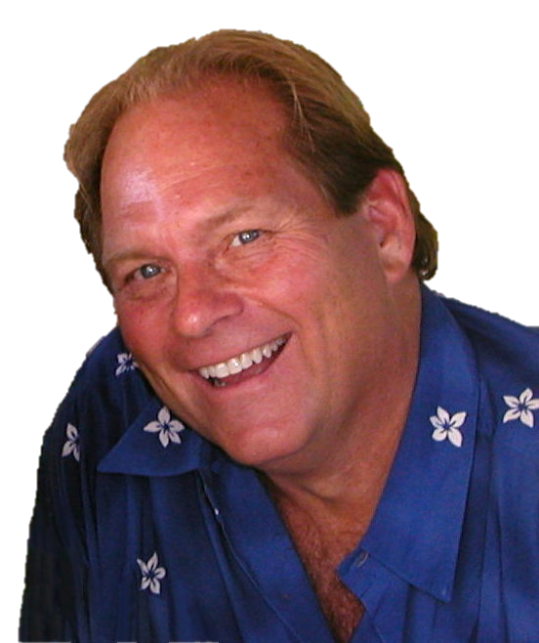
Ibn Al-Haytham
World’s First Scientist!
World’s First Scientist!
  Steffens, Bradley (2006), Ibn al-Haytham: First Scientist
Greatest Physicists of the Medieval times
  Sarton, George (1927), Introduction To The History of Science, Volume I: From Homer To Omar Khayyam,
Bradley Steffen

Slide 60

Ibn Al-Haytham
Best Idea in 1000 years!
Scientific method and scientific skepticism as the most influential idea of the second millennium! (1000 CE – 1999 CE)
Powers, Richard (April 18, 1999), "Best Idea; Eyes Wide Open” [New York Times]
http://www.nytimes.com/library/magazine/millennium/m1/powers.html

Slide 61
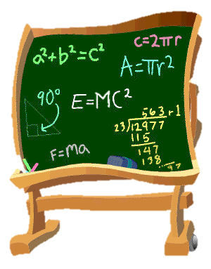
Mathematics

Slide 62
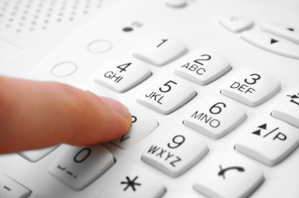
Arabic Numerals
Introduce by Muslims
Introduced by Muslims to the West

Slide 63



Al-Khwārizmī – 820 CE
Father of Algebra, Algorithm

Slide 64

Carly Fiornioa, CEO of Hewlett Packard
On Muslim Civilization
Carly Fiorina, CEO Hewlett Packard, Sept. 2001 on Mathematics by Muslims
“And this (Muslim) civilization was driven more than anything, by invention. Its architects designed buildings that defied gravity and its mathematicians created algebra and algorithms that would enable the building of computers and the creation of encryption.”
Carly Fiornia, CEO of Hewlett Packard, speech on ‘Technology, Business and Our Way of Life: What’s Next?” in Minnesota, Sept 26, 2001.

Slide 65

Education

Slide 66

Prophet Muhammad Said:
(Peace be upon him)
“The seeking of knowledge is obligatory for every Muslim…”
(Al-Tirmidhi Hadith 218)

Slide 67

World Oldest University
Built by Muslims – 859 CE
University of Al-Karaouine
Fes, Morocco – 859 CE
Built by Fatima al-Fihri
The Guinness Book Of Records, Published 1998, ISBN 0-5535-7895-2, P.242

Slide 68

Al-Azhar University
2nd oldest in the world
Cairo, Egypt – 975 CE

Slide 69

Libraries

Slide 70

Islamic Libraries
Collection of ancient manuscripts
Translating work of Greek, Roman scholars
Lending to public
Books catalogued
Concept of Muslim libraries copied by Christian monks
  Introduced to the western = today’s libraries
--------------
Micheau, Francoise, "The Scientific Institutions in the Medieval Near East", pp. 988–991 in Morelon, Régis & Roshdi Rashed (1996), Encyclopedia of the History of Arabic Science, vol. 3, Routledge, ISBN 0415124107

Slide 71
Libraries
Daar al-Hikmah – House of Wisdom – Cairo –
  18,000 ancient books
Bayt al-Hikman – House of Wisdom – Baghdad
  Haroon Rasheed – Defeated Roman king
    Reward – Muslims will translate all the books in possession of the Romans
Al-Hakam – Spain
  400,000 books
Bani Ammaar – Tripoli – Libya
  1 million books

Slide 72
What happened to these libraries?
Tartars conquered Baghdad – destroyed books – 1258 CE
Crusaders – Destroyed libraries in Jerusalem, Gaza, Tripoli
Spanish Inquisition – 1 million books burned in one day in Granada

Slide 73

Language

Slide 74






What do these things have in common?
Coffee
Orange
candy
soda
Algebra
Cotton

Slide 75






What do these things have in common?
Sofa
Can
Giraffe
Magazine
Sugar
Numerals

Slide 76
They are all derived from…
Arabic words

Slide 77
Arabic words in other languages
1000 plus in English
1000 plus in Spanish
1000 plus in Portuguese
French
Sicilian

Slide 78

Architecture

Slide 79

ARCHITECTURE
Taj Mahal - India

Slide 80

Blue Mosque
Istanbul - Turkey

Slide 81

Dome of the Rock- Jerusalem – 691 CE

Slide 82

Al Canzar - Seville

Slide 83

AlHambra Palace
Granada - Spain

Slide 84

Cities

Slide 85

City of Cordoba
Spain – 1000 years ago
Lighted Streets
  10 miles radius outside the city
  Paved Streets
Garbage was regularly picked from streets
City surrounded by Gardens
One million citizens
  London, Paris – 25, 000 citizens

Slide 86
City of Cordoba
Spain – 1000 years ago
100% Literacy rate
50 Hospitals
80 schools
  FREE education
600 Mosques
900 Baths

Slide 87

Contributions of Muslims in the USA

Slide 88




Architecture
Fazlur R. Khan, main architect of…
John Hancock Center, Chicago
Willis (Sears) Tower, Chicago
One Shell Plaza
Houston

Slide 89






Sports
Ahmad Rashad
Kareen Abdul-Jabbar
Muhammad Ali
Hakeem Olajuwon
Rashaan Salaam
Mahmoud Abdul-Rauf

Slide 90


Politics
700 Muslim Candidates ran for election
Keith Ellison - First Muslim Congressman
Charles Bilal -Kountze, Texas ,Nation’s first Muslim Mayor
Keith Ellison
First Muslim
In US Congress
Andre Carson
Second Muslim in US Congress

Slide 91


Armed Forces
20,000 Muslims serve

Slide 92


Muslim Humanitarian Aid
2000 Muslim volunteers for Katrina
‘…righteousness is this that one should believe in Allah and the last day and the angels and the Book and the prophets, and give away wealth out of love for Him to the near of kin and the orphans and the needy and the wayfarer and the beggars and for (the emancipation of) the captives…’ (The Quran 2:177)
$15 Million in Aid

Slide 93


Muslim Physicians in USA
20,000 Muslim Physicians in USA
In all major hospitals
In All major specialties
Volunteer with Free Clinics
Accommodate the millions of unisured

Slide 94






Contributions in other fields

Slide 95









Famous Converts to Islam
Can you name them?

Slide 96
Famous Converts to Islam
Can you name them?
Cat Stevens – Former Pop Singer
Yvonne Ridley – British Journalist
Charles Buchanan – Nephew of the President
Ali
Mario Scialoja
Italian Ambassador
Murad Hoffman – German Ambassador
Maurice Bucaille
French Physician
Jeffrey Lang
Professor KSU
Ingrid Mattson
President ISNA

Slide 97

What can Islam offer today?
Spiritual enhancement of the society
Moral enhancement of the society
Economic enhancement of the society
Physical enhancement of the society

Slide 98

Islam Provides
Solutions to Societies Problems
  Obesity
  Racism
  Homicides
  Rapes
  Downed economy
  Drugs – intoxicants
  Divorce
  Theft
  Suicides
  Violence

Slide 99

Islam for Today
"I have always held the religion of Muhammad in high estimation because of its wonderful vitality. it is the only religion which appears to me to possess that assimilating capacity to the changing phase of existence which can make itself appeal to every age.
I have prophesied about the faith of Muhammad that it would be acceptable to the Europe of tomorrow as it is beginning to be acceptable to the Europe of today.“
H.G.Wells – The Genuine Islam, Vol. 1, No. 8 1936

Slide 100

President Obama on Islam

Slide 101
President Obama on Islam – Cairo 2009
“As a student of history, I also know civilization's debt to Islam. It was Islam -- at places like Al-Azhar -- that carried the light of learning through so many centuries, paving the way for Europe's Renaissance and Enlightenment. It was innovation in Muslim communities -- (applause) -- it was innovation in Muslim communities that developed the order of algebra; our magnetic compass and tools of navigation; our mastery of pens and printing; our understanding of how disease spreads and how it can be healed. Islamic culture has given us majestic arches and soaring spires; timeless poetry and cherished music; elegant calligraphy and places of peaceful contemplation. And throughout history, Islam has demonstrated through words and deeds the possibilities of religious tolerance and racial equality. ”

Slide 102
More info on Islam
GainPeace.com
For free Quran & Literature
  800-662-ISLAM
Want to discuss Islam?
Want to embrace Islam?
  800-662-ISLAM
  info@GainPeace.com
  More Islam slides here: http://www.slideshare.net/sabeel/presentations
GainPeace is an outreach project of
Islamic Circle of North America, ICNA

Slide 103
GainPeace
Through Islam

