Slide 1
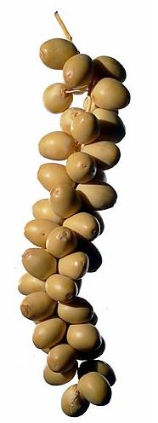
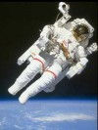
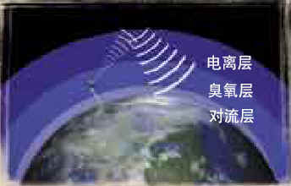
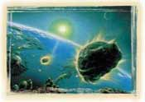
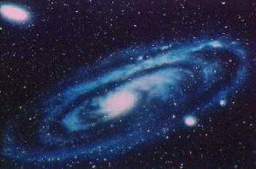

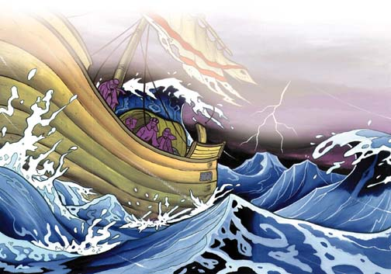
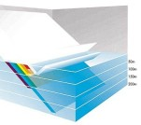
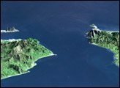
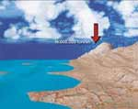
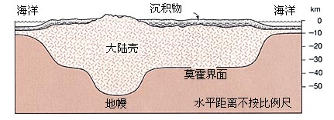
地球與太空
月球的軌跡
日月之光
升空的感覺
晝夜互纏繞
回歸的天
安全的穹窿
宇宙在擴展
雨水滲入地裡
群山如行雲
海底烈焰
海洋深處
海洋互不混合
山巒如木樁
定量的雨水

Slide 2
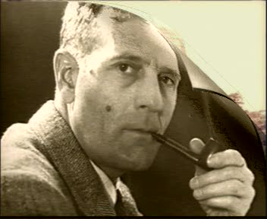
宇宙在澎漲中
1929年，美國天文學家哈勃用望遠鏡發現「紅移」現象 ， 顯示星體移離地球
後來進一步證明星體各自移離
結論→宇宙在澎漲中
哈勃
(Edwin HUBBLE)
1929

Slide 3
宇宙在擴展中
「宇宙，我用力量建築了它，我實是在擴展它。」
(古蘭經 51：47)
Maurice Bucaille, The Bible, The Qur'an and Science. U.S.A., 1978. p. 181
Harun Yahya, Miracles of the Qur’an. Turkey, 2001. p.14– 5
Muhammad Asad, The Message of the Quran. 51:47.

Slide 4

宇宙在擴展中
為何《古蘭經》的作者在 1,400 年前已知道宇宙擴展的真相呢？

Slide 5

人升入高空時的感覺
「真主欲使誰遵循正道，就使誰的心胸為伊斯蘭而敞開，真主欲使誰誤入迷途，就使誰的心胸感到憋悶，好似要登天。」
狹隘
(古蘭經 6：125)
緊
*註
(埃爾莫格拉比, “人升入高空時的感覺”，1987年伊斯蘭堡舉行之「首屆古蘭與聖訓中的科學奇跡國際研討會」)

Slide 6
大氣層不為人知，直至1648年帕斯卡(Pascal)證實其存在
他證明海拔越高，氣壓越低
關於高空對人影响的許多研究大約始於200多年前(1786年)，而對高空生理反應的較先進的研究僅30多年前(1978年)才開始
高空由於缺氧及低壓，導至人體組織內分解出氣體，氣體膨脹，令人胸痛
以上古蘭經所提胸部的憋悶，與科學發現吻合
古蘭經的作者如何洞悉今日的新知？

Slide 7
大氣層不為人知，直至1648年帕斯卡(Pascal)證實其存在
他證明海拔越高，氣壓越低
關於高空對人影响的許多研究大約始於200多年前(1786年)，而對高空生理反應的較先進的研究僅30多年前(1978年)才開始
高空由於缺氧及低壓，導至人體組織內分解出氣體，氣體膨脹，令人胸痛
以上古蘭經所提胸部的憋悶，與科學發現吻合
古蘭經的作者如何洞悉今日的新知？

Slide 8
日月之光
「真主尊大，衪在天上造了星宿並在天上造了燈( سِرَاجاً siraj) 和明月( مُّنِيراً munir)。」
(古蘭經 25：61)

Slide 9
日月之光
siraj (سِرَاجاً)是發光發熱的燈或火炬
munir (مُّنِيراً ) 是借或反射之意
《古蘭經》的作者在用字遣詞上， 表明衪是洞悉日月之光的分別
( Maurice Bucaille, The Bible, The Qur'an and Science. U.S.A., 1978. p. 167-9 )

Slide 10
日夜繞轉
「衪以真理造化諸天與大地，衪使夜繞著晝、晝繞著夜轉，衪也使日月服從，它們各自循著一個規定的時期運行，難道衪還不是大能的、多恕的嗎？」
(古蘭經 39：5)

Slide 11
「繞」字阿文 kawara(كور)是纏繞之意
說明日與夜是如何替換的
也正是因為地球自轉，所以日與夜是如此纏繞著
自西元二世紀，地球為中心之說，在西方一直為人接受
直到十六世紀哥白尼才證明地球圍繞太陽轉
1609年德國天文學家才指出行星本身亦自轉
( Maurice Bucaille, The Bible, The Qur'an and Science. U.S.A., 1978. p. 177-8 )

Slide 12
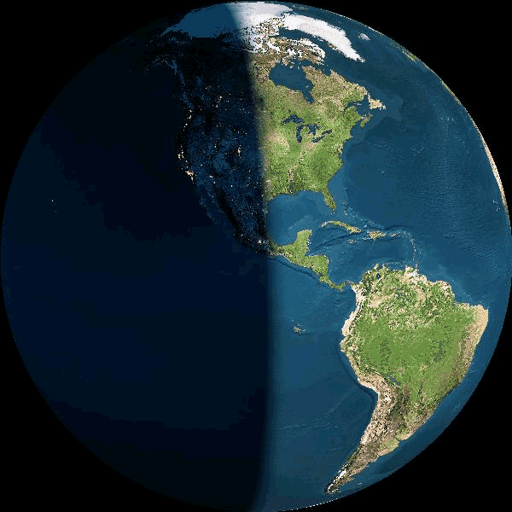

晝
夜
夜
晝

Slide 13
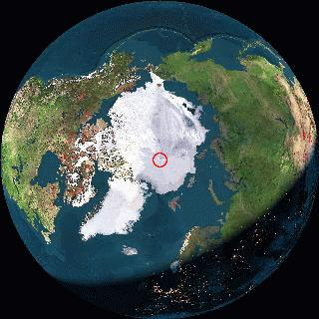
晝
地球自轉
北極
夜

Slide 14
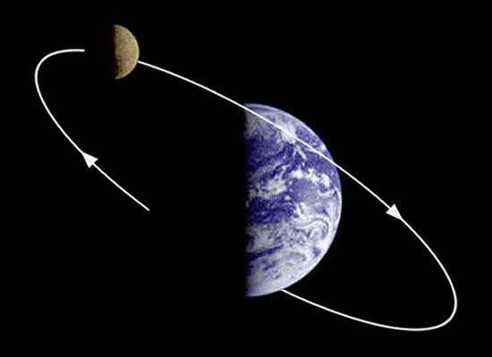
月球的軌跡

Slide 15
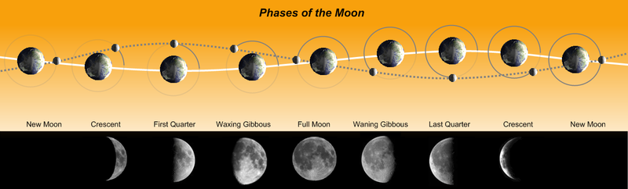
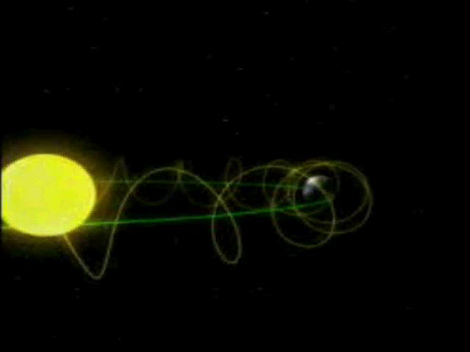
月球的軌跡
月相
新月(朔)
娥眉月
上弦月
下弦月
殘月
張弦月
滿月
張弦月
新月
參考：《維基百科》http://en.wikipedia.org/wiki/Moon_phase( 2010.07.10)
Notes:
參考： http://www.answering-christianity.com/moon_orbit_miracle.htm

Slide 16
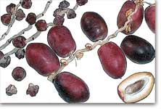
月球的軌跡
月相
新月(朔)
娥眉月
上弦月
下弦月
殘月
張弦月
滿月
張弦月
新月
「月亮，我也規定了她的(運行的)階段，直到她變成象乾枯的棗枝。」 (古蘭經 36：39)

Slide 17
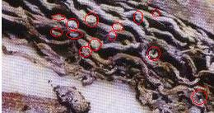
月球的軌跡
月相
新月(朔)
娥眉月
上弦月
下弦月
殘月
張弦月
滿月
張弦月
新月
「月亮，我也規定了她的(運行的)階段，直到她變成象乾枯的棗枝。」 (古蘭經 36：39)

Slide 18
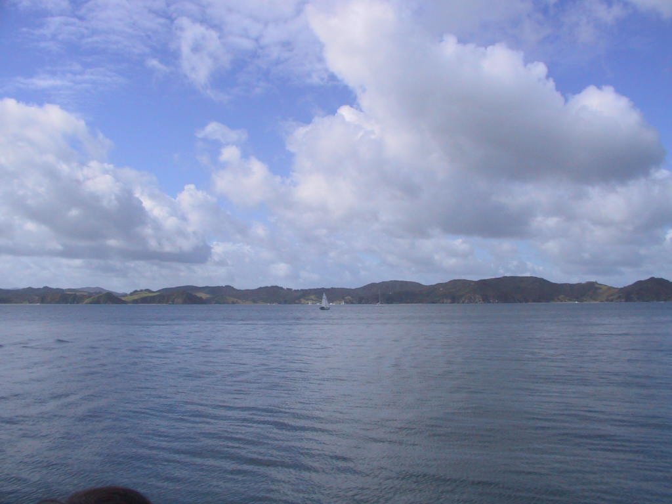
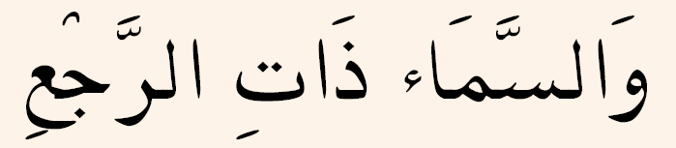
「憑降下甘霖的天。」
(古蘭 86:11)

Slide 19
(古蘭 86:11)
回歸
返回
循環
[ Harun Yahya, Miracles of the Qur’an, Turkey, 2001. p.26 – 27 ]

Slide 20
「憑回歸的天。」
(古蘭 86:11)

Slide 21
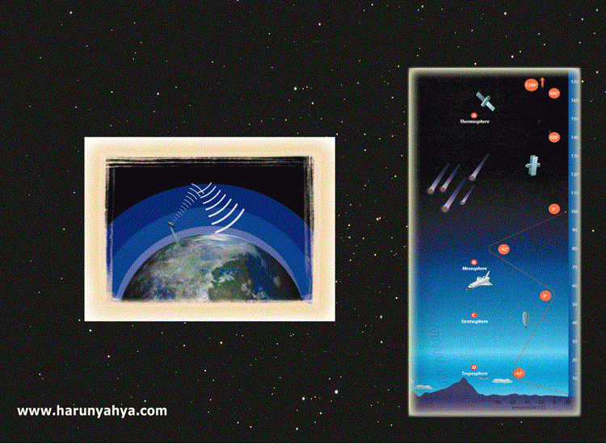
回歸的天
Notes:
This word interpreted (açıklanmış olan) as "cyclical" in Qur'an translations also has meanings of "sending back" or "returning".
As known, the atmosphere surrounding the Earth consists (oluşmuş olmak) of many layers. Each layer serves an important purpose for the benefit of life. Research has revealed that these layers have the function of turning the materials or rays they are exposed to back into space or back down to the Earth. Now let us examine with a few examples of this "recycling" function of the layers encircling the Earth.
The troposphere, 13 to 15 kilometers above the Earth, enables water vapor rising from the surface of the Earth to be condensed (yoğunlaştırılmış) and turn back as rain.
The ozone layer, at an altitude of 25 kilometers, reflects harmful radiation and ultraviolet light coming from space and turns both back into space.
The ionosphere, reflects radio waves broadcast from the Earth back down to different parts of the world, just like a passive communications satellite, and thus makes wireless communication, radio, and television broadcasting possible over long distances.
The magnetosphere layer turns the harmful radioactive particles emitted by the Sun and other stars back into space before they reach the Earth.
The fact that this property of the atmosphere's layers, that was only demonstrated in the recent past was announced centuries ago in the Qur'an, once again demonstrates that the Qur'an is the word of God.

Slide 22
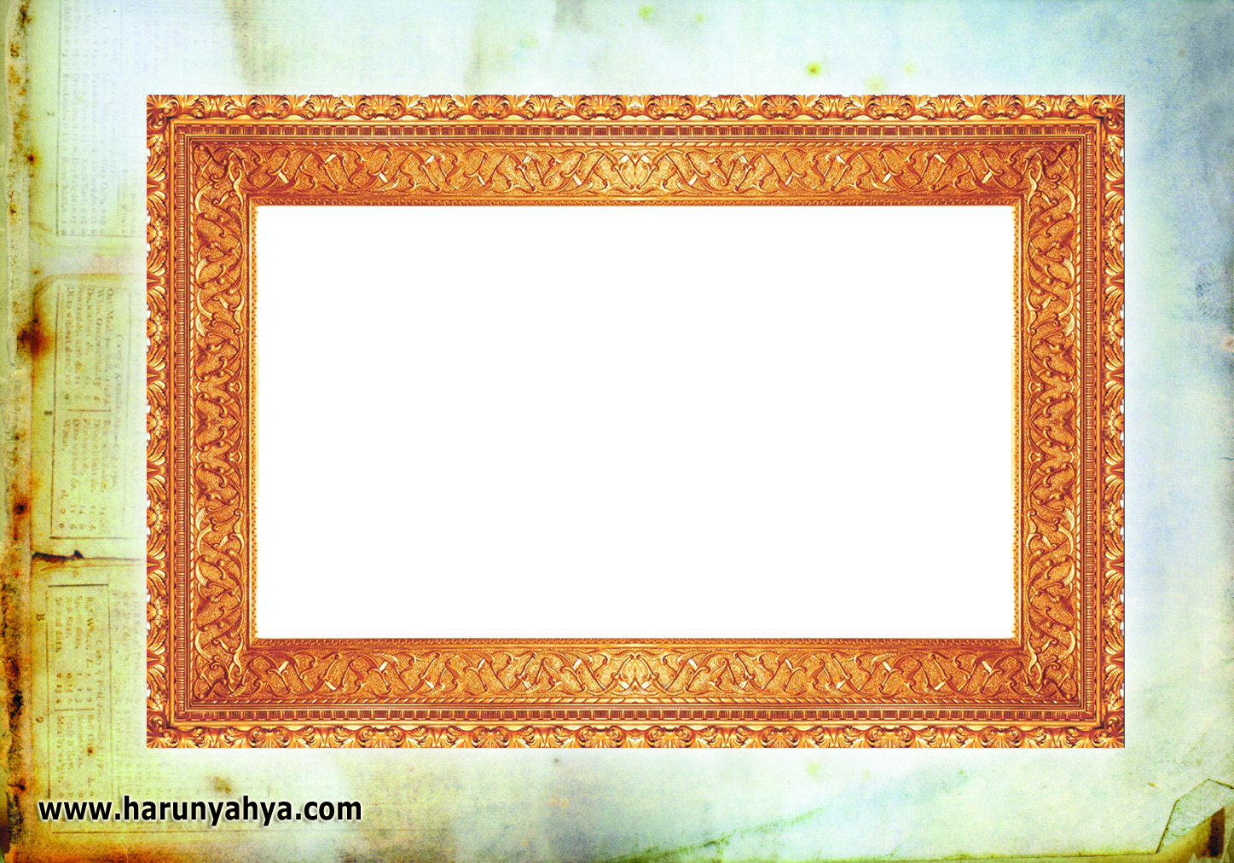
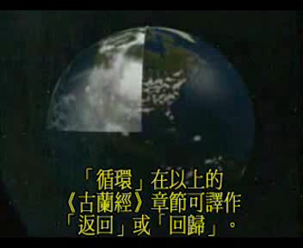
回歸的天
研究揭露各層大氣有以下功能

Slide 23
回歸的天
大氣層的功能：
「對流層」將從地面上升的水蒸氣凝結成雨降回地球
「臭氧層」反射太空的有害幅射和紫外光返回太空
「電離層」反射地球播放的無線電波回到地球上不同地方，使無線電通訊、收音與電視廣播傳送遠處

Slide 24


我把天造成安全的穹窿，而他們忽視其中的蹟象。
(古蘭 21:32)

Slide 25
我把天造成安全的穹窿，而他們忽視其中的蹟象。
(古蘭 21:32)

Slide 26
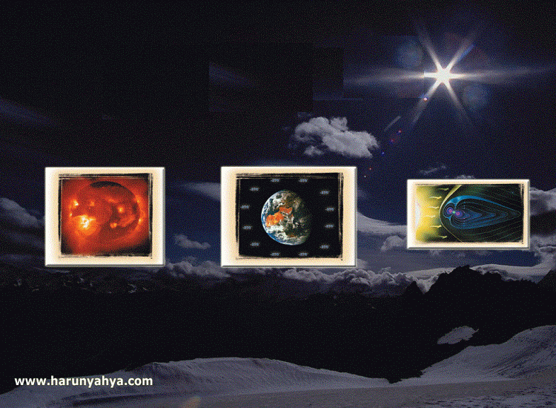
安全的穹窿
宇宙綫的侵襲
太陽有害的放射
太空的酷寒
Notes:
大氣保護地球免被隕石侵襲
隕石是從星球分裂出來的石塊或星球爆炸遺留的殘餘部份，它們在太空中浮游，有時會墜落星球，造成嚴重的破壞。但，由於安拉的慈憫，衪使地球受一層空氣圍繞着形成保護罩，使隕石對我們不會造成很大的傷害。
大氣層圍繞着地球，形成保護罩；全賴氣層的保護，使我們在未知情之下免於很多威脅，
(This attribute of the sky has been proved by scientific research carried out in the 20th century.)

Slide 27
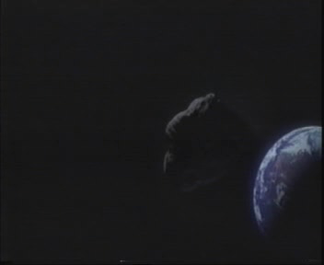
大氣層粉碎大部份撞擊地球的隕石
Notes:
The atmosphere surrounding the earth serves crucial (çok önemli) functions for the continuity of life. While destroying many meteors big and small as they approach the earth, it prevents them from falling to earth and harming living things.

Slide 28
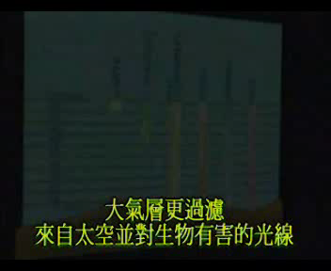
大氣層過濾外來損害生物的輻射
[ Harun Yahya, Miracles of the Qur’an, Turkey, 2001. p.22 – 25 ]
Notes:
In addition, the atmosphere filters the light rays coming from space that are harmful to living things. Interestingly, the atmosphere lets only harmless and useful rays– visible light, near ultraviolet light, and radio waves pass through. All of this radiation is vital (hayati) for life. Near ultraviolet rays, which are only partially let in by the atmosphere, are very important for the photosynthesis of plants and for the survival of all living beings. The majority of the intense ultraviolet rays emitted (salınmış olan) from the sun are filtered out by the ozone layer of the atmosphere and only a limited–and essential (zorunlu) –part of the ultraviolet spectrum reaches the Earth.
The protective function of the atmosphere does not end here. The atmosphere also protects the earth from the freezing cold of the space, which is about minus 270o C.

Slide 29
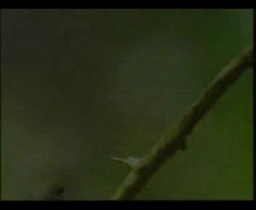
地磁場如盾甲保護地球免受宇宙綫的傷害
Notes:
It is not only the atmosphere that protects the Earth from harmful effects. In addition to the atmosphere, the Van Allen Belt, a layer caused by the magnetic field of the Earth, also serves as a shield against the harmful radiation that threatens our planet. This radiation, which is constantly emitted by the Sun and other stars, is deadly to living things. If the Van Allen belt did not exist, the massive outbursts of energy called solar flares (alev) that frequently occur in the Sun would destroy all life on Earth.
Dr. Hugh Ross has this to say on the importance of Van Allen Belts to our lives:
In fact, the Earth has the highest density of any of the planets in our Solar System. This large nickel-iron core is responsible for our large magnetic field. This magnetic field produces the Van-Allen radiation shield, which protects the Earth from radiation bombardment. If this shield were not present, life would not be possible on the Earth. The only other rocky planet to have any magnetic field is Mercury - but its field strength is 100 times less than the Earth's. Even Venus, our sister planet, has no magnetic field. The Van-Allen radiation shield is a design unique to the Earth.
The energy transmitted in just one of these bursts detected in recent years was calculated to be equivalent to 100 billion atomic bombs similar to the one dropped on Hiroshima. Fifty-eight hours after the burst, it was observed that the magnetic needles of compasses displayed unusual movement and 250 kilometers above the earth's atmosphere, the temperature suddenly increased to 2,500o C.
In short, a perfect system is at work high above the Earth. It surrounds our world and protects it against external threats. Scientists only learned about it recently, yet centuries ago, God informed us in the Qur'an of the world's atmosphere functioning as a protective shield.

Slide 30
群山如行雲
「你見群山而以為都是固定的，其實群山都象行雲樣經過(تَمُرُّ)*。那是精製萬物的真主的化工，他確是徹知你們的行為的。」
(古蘭經 27：88)
*注： تَمُرُّ(現在式)；行走、經過的意思。
( 馬堅譯：逝去；林松譯：飄浮 )
[ Harun Yahya, Miracles of the Qur’an, Turkey, 2001. p.34 – 5 ]

Slide 31
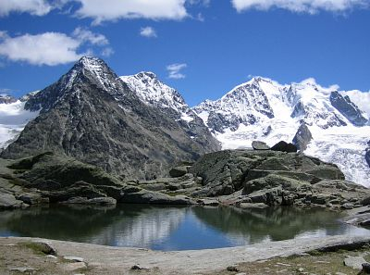

Slide 32
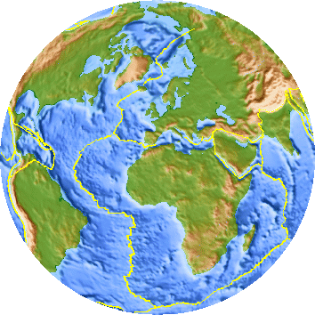
原來群山的確在移動中

Slide 33

海底的烈焰
「以包含著熾熱的物質和烈焰的大海盟誓。」
(古蘭經 52：6)

Slide 34
1850年以前，人們認為海底是平坦的平原
由於鋪設海底電纜才開始勘探海底
海底有山脈，內有熾熱的岩漿
《古蘭經》的作者從那裡得悉這真相呢？
(穆斯塔法‧艾罕默德, “大洋中脊和海底烈焰”，1987年伊斯蘭堡舉行之「首屆古蘭與聖訓中的科學奇跡國際研討會」)

Slide 35
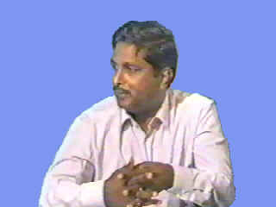
德路加‧朗教授 Professor Dorja Rao
沙烏地阿拉伯吉達
國王阿布達濟茲大學海洋地質學教授
Professor of Marine Geology
King Abdulaziz University,
Jeddah, Saudi Arabia.

Slide 36
海洋深處
善丹尼長老對朗教授向朗教授展示的其中一節：
「(不信的人的處境)或像在深海的黑暗中，浪上有浪，浪上有雲，層層的黑暗， 如果他伸出手，幾乎就看不到它 .... 」
（古蘭經 24 ：40 ）*
* 馬金鵬譯

Slide 37
海洋深處
朗教授確認經過現代科技的協助，我們發現深海確是漆黑的：
海洋深水域的暗處約位於 200米或以下的深度。 在這一深度，幾乎沒有光線。
1,000 米以下則完全沒有光線。
若無潛艇或特殊裝備輔助，人類無法潛到 40 米以下。

Slide 38
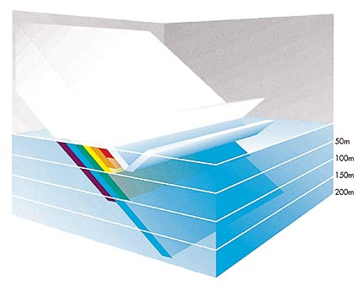
海洋深處
紅光：在 10米內被吸收
橙光：在 30來內被吸收
黃光：在 50米內被吸收
綠光：在100米內被吸收
藍光：在200米內被吸收
海平面會反射 3% 到 30% 的陽光。 因此除了藍光之外，光譜中的七種色彩幾乎會在前 200 米逐一被吸收。
[ Elder(愛爾德) & Pernetta(巴內特), Oceans 《海洋》. p. 27 ]

Slide 39
海洋深處
以上的《古蘭經》：「...在深海的黑暗中，浪上有浪，浪上有雲，層層的黑暗....」
海洋的深水域上波濤澎湃，而這些波浪之上又是另一層波浪
很明顯的，最頂層的波浪即是我們所見的海平面波浪，因爲《古蘭經》章節中提到其上爲雲
下層的波浪又是什麽？ 科學家最近發現不同密度層之間的銜接處存在「內波」

Slide 40
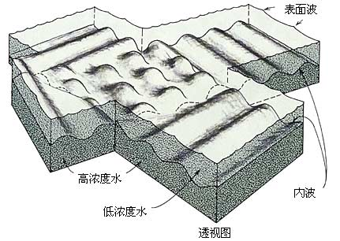
海洋深處
海洋不同密度層之間的銜接處存在「內波」
[ Gross(葛雷斯), Oceanography《海洋學》. p.204 ]

Slide 41
海洋深處
朗教授：
「這類知識在1,400年前已經存在是十分難以想像的。也許他們對一些事情有簡單的想法, 但對細節有這樣詳盡的描述是非常困難的。所以, 這肯定不是一般人類的知識。正常人無法解釋這種現象細節。因此，我認為資訊一定是來自一個超自然的源頭。」

Slide 42
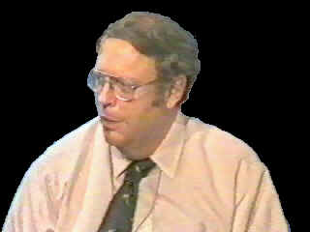
威廉‧哈伊博士 Dr. William W. Hay
美國科羅拉多巨石城
科羅拉多大學海洋地理學教授
Professor of Oceanography,
University of Colorado, Boulder, Colorado, USA.

Slide 43
哈伊博士是美國其中一位最著名的海洋科學家
善丹尼長老向他詢問許多有關海洋表面的問題， 如有關海洋上層與下層的分割、海牀和海洋地質學等
哈伊博士解釋關於海與海的分隔時：
不同海洋的水看似同質的，但由於其温度、鹽度、密度不同，因而兩海的水可是兩種不同的東西
例如：

Slide 44
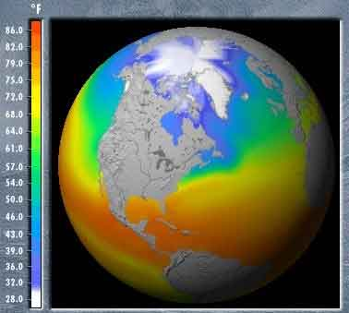
不同海洋的水的温度、鹽度、密度不同

Slide 45
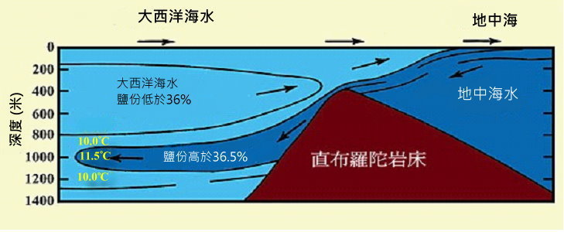
(最早於1942年繪製)
地中海的海水，從直布羅陀海底山脊的上方進入大西洋後仍能保持其本身溫暖、含鹽及低密度的特質，是因爲這條界限將它們隔開。 (溫度以攝氏表示 )
[ Kuenen (昆甯), Marine Geology 《海洋地質學》, p. 43 ] (稍有修改)

Slide 46
大西洋
但真主在《古蘭經》說：
西班牙
摩洛哥
「他曾任兩海相交而會合。 兩海之間，有一個堤防。 兩海互不侵犯。」
地中海
直布羅陀海陝
（古蘭經 55：19-20）

Slide 47
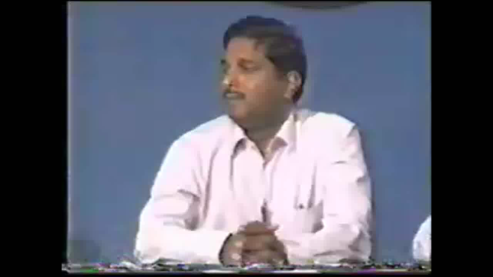
Dr. William Hay,
“ I find it very interesting that this sort of information is in the ancient scriptures of the Holy Qur'an, and I have no way of knowing where they would have come from. But I think it is extremely interesting that they are there and this work is going on to discover it, the meaning of some of the passages.”
And when he was asked about the source of the Qur'an, he replied, “ Well, I would think it must be the divine being. ”

Slide 48
「在《古蘭經》這樣古老的典籍中發現這類資訊，令我感到非常有趣。並且，我無法得知它們來自何處。但我認為這些與真相吻合的章節的存在是極端有趣的，這些研究工作將有助發現其含義。」
並且，當他被詢問有關《古蘭經》的來源時, 他回答說： 「那麼，我認為它必定是來自神。」

Slide 49
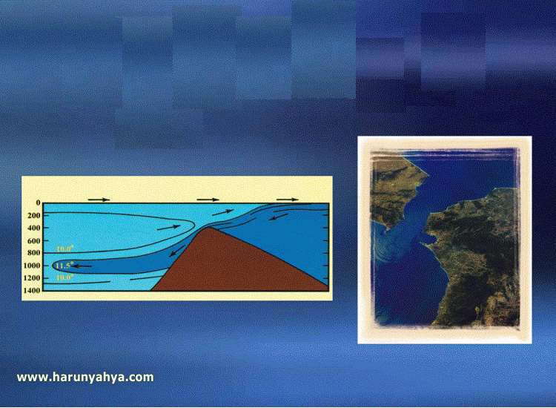
兩海不相混合
兩海匯合而不混合
[ Harun Yahya, Miracles of the Qur’an, Turkey, 2001. p.48–9 ]

Slide 50
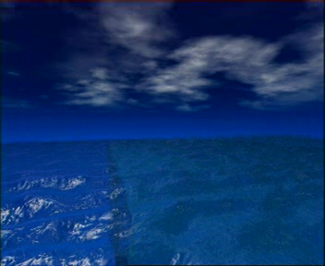
海洋密度不同→表面張力防止海水混合
Notes:
This property of the seas, that they come together yet do not mingle with one another at all, has only very recently been discovered by oceanographers. Because of the physical force called "surface tension", the waters of neighboring seas do not mix. Caused by the difference in the density of their waters, surface tension prevents them from mingling with one another, just as if a thin wall were between them.
The interesting side to this is that during a period when people had no knowledge of physics, surface tension, or oceanography; this was revealed in the Qur'an.

Slide 51
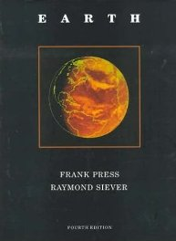
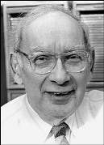
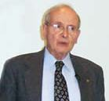
山巒如木樁
Raymond Siever
(1923-2005)
Prof. of Geology, Emeritus
Harvard University
Earth《地球》(1986)
Frank Press (1924- )
President of the National Academy of Sciences in USA. (12 years)
山在地表下有深根
[ Frank Press(普雷斯) & Siever (西瑞爾)， Earth 《地球]》，p. 413. ]
Notes:
Professor Siaveda : …..But from the viewpoint of densities, they (the roots of mountain) are doing the same job of supporting the mountains. Therefore, the function of the roots are to support the mountains according to the law of Archimedes."
Professor Siaveda described the shape of all mountains whether they are on land or in the sea as being in the shape of a wedge. Could anyone during the time of Prophet Muhammad (s.a.w.) have known of the shape of these mountains? Could anyone imagine that the solid massive mountain that he sees before him actually extends deep into the earth and has a root as scientists assure? A large number of geography books when discussing mountains, only describe that part which is on the surface of the earth. This is because they are not written by specialists in geology, but modern science informs us about it and Allah says in the Qur'aan: And the mountains as pegs. (Qur'aan 78:7).
We asked Professor Siaveda whether the mountains have a function in establishing the crust of the earth. He said that this has not yet been discovered and established by scientists. In view of the reply we researched and inquired about this and we found out that many geologists gave the same reply, except for a few. Among those few are the authors of this book, entitled �The Earth�. This book is considered as a basic reference text in many universities throughout the world. One of the authors of this book is Frank Press. He is currently the President of the Academy of Sciences in USA. Previously, he was science advisor to former U.S. President Jimmy Carter. What does he say in his book? He illustrates the mountains in a wedge-like shape where the mountain itself is but a small part of the whole whose root is deeply entrenched in the ground. Dr. Press writes on the functions of the mountains and states that they play an important role in stabilizing the crust of the earth. This is exactly how the Qur'aan described mountains 14 centuries ago.
And the mountains Has He firmly fixed. (Qur'aan 79:32).
And He said: And the mountains as pegs. (Qur'aan 78:7).
And He also said: And he has set up on the earth mountains standing firm, lest it should shake with you. (Qur'aan 16:15).

Slide 52
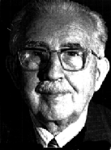
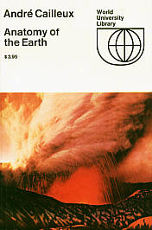
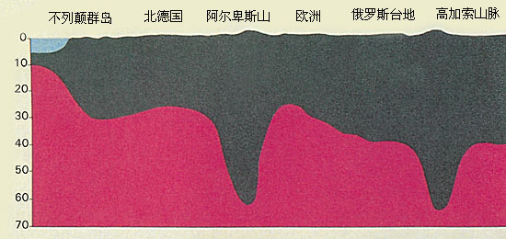
山巒如木樁
André Cailleux
(1907-1986)
狀似木樁的山 ，有植入土地的深根根
[ Cailleux(西里士), Anatomy of the Earth《地球結構》, 1976 . p.220 . ]

Slide 53
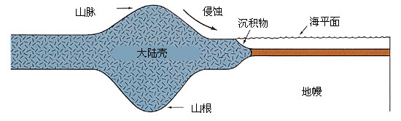
山巒如木樁
上圖顯示這些深根怎樣使所在的山狀似木樁
[ Tarbuck(塔貝克)& Lutgens(陸得基)， Earth Science《地球科學》，p.158 . ]

Slide 54
「難道我沒有使大地如搖籃，使山巒如木樁嗎？ 」
（古蘭經 78：6-7）

Slide 55
「他從雲中降下有定量的雨水，借雨水而使已死的地方復活。…」
(古蘭 43:11)

Slide 56
「他從雲中降下有定量的雨水，借雨水而使已死的地方復活。 … 」
(古蘭 43:11)

Slide 57
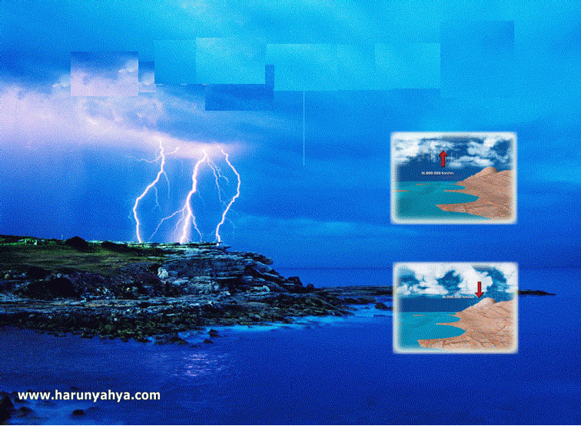
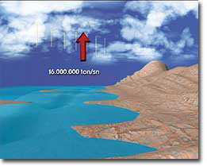
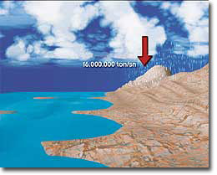
定量的雨水
現代科學研究發現：
每秒約有 1,600 萬噸水從地球蒸發
一年蒸發 513兆噸水(5.13 x 10¹⁴噸)
相等於每年降雨量
[ Harun Yahya, Miracles of the Qur’an, Turkey, 2001. p.40 – 41 ]

Slide 58
雨水滲入地裏成泉源
「你豈未見真主自上空降下雨水， 使它滲入地裏成為泉源。然後，借它生出顏色不一的植物。」
(古蘭經 39:21)

Slide 59
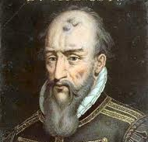
雨水滲入地裏成泉源
(1510-1589)
自西元前七世紀至十八世紀，人認為地下泉水來自海洋的水蒸發後，由風刮回內陸，通過巨大深淵再返回大海。柏拉圖稱之為「地冥」(Tartarus) 。
至十六世紀 伯那特‧貝利希( Bernard Palissy)首先提出正確的水循環過程 (西元1580年)
今天，我們知道雨水滲入地下造成泉水 ；但古蘭經卻未受穆聖年代的錯誤觀念影响
[ Maurice Bucaille, The Bible, The Qur'an and Science. U.S.A., 1978. p. 124 ]

